Slide 1
Sales Tax Resources: Your Essential Toolkit

Slide 2

Strategist, advisor, speaker, and author
President of YETTER
Founder of the Sales Tax Institute
Testified before Senate Finance Committee
Accounting Today’s 100 Most Influential People in Accounting for 8 times between 2011 and 2022
Woman Business Owner of the Year 2020
Diane L. Yetter

Slide 3
Introduction

Slide 4
Why Do You Need Resources?
Monitoring nexus
Increasing awareness and application of law changes
Staying informed on major rate changes
Managing audits and preparing documentation
Manipulating and analyzing data
Researching taxability
Expanding knowledge
Identifying business impacts
Updating systems
Networking

Slide 5
Benefits of Resources
Saving time
Reducing costs
Minimizing effort
Increasing accuracy
Employing a proactive approach
Obtaining current, updated, or new information to apply or monitor

Slide 6
Tax Information Resources

Slide 7

Free Resources
Accounting Firms
Consulting Firms
Law Firms
Google Search
Google Alerts
Published Legal Documents

Slide 8
Sales Tax Institute Free Resources
Available at https://www.salestaxinstitute.com/resources
Sales Tax Guides and Whitepapers
  Nexus, Sales Tax Administration, Exemptions, Audits and more.
Charts
  State Sales Tax Rates, Economic Nexus, Remote Seller Nexus, Sales Tax Amnesty Programs, Sales Tax Holidays
News & Tips
  Covers many different industries/topics. Updated regularly.

Slide 9
Government Resources
State/Local Department of Revenue (DOR) Websites
  Find rate lookups, administrative regulations, letter rulings, FAQs, and more.
  See the PDF for links.
State/Local Legislative Websites
  View bills (proposed and enacted) and bill history, legislative session information, legal resources, and more.
  See the PDF for links.

Slide 10
Government Resources
State/Local Statutes, Regulations, and Bulletins
Streamlined Sales Tax https://www.streamlinedsalestax.org/
  SST Agreement, Disclosed Practices, Participating states, Remote and Marketplace Seller resources, SST Exemption Certificate, and more.
Multistate Tax Commission https://www.mtc.gov/
  MTC Resale Certificate, Multistate Voluntary Disclosure, Audit resources, and more.

Slide 11
Government Resources
Municode – https://library.municode.com/
  Municipal codes and resources
General Code - https://www.generalcode.com/library/
  Municipal codes
  Zoning information

Slide 12
Research Paid Resources
Bloomberg - https://pro.bloombergtax.com/
  Forms, rate lookup tables, automated tax liability calculation, automatic rate update. Includes Superform Service (calculating forms)
CCH/Wolters Kluwer - https://www.wolterskluwer.com/en/solutions/tax-accounting-us
  Forms, research tools and publications, Calculation package, rates, returns package and software as a service
  Daily newsletter alert
  Printed Books

Slide 13
Research Paid Resources
MultiState - https://www.multistate.us/
  Legislative tracking
  Lobbyist
Council on State Taxation (COST) – www.cost.org
  State tax resources, bill tracking, studies and reports, and more.
  Various email newsletters

Slide 14
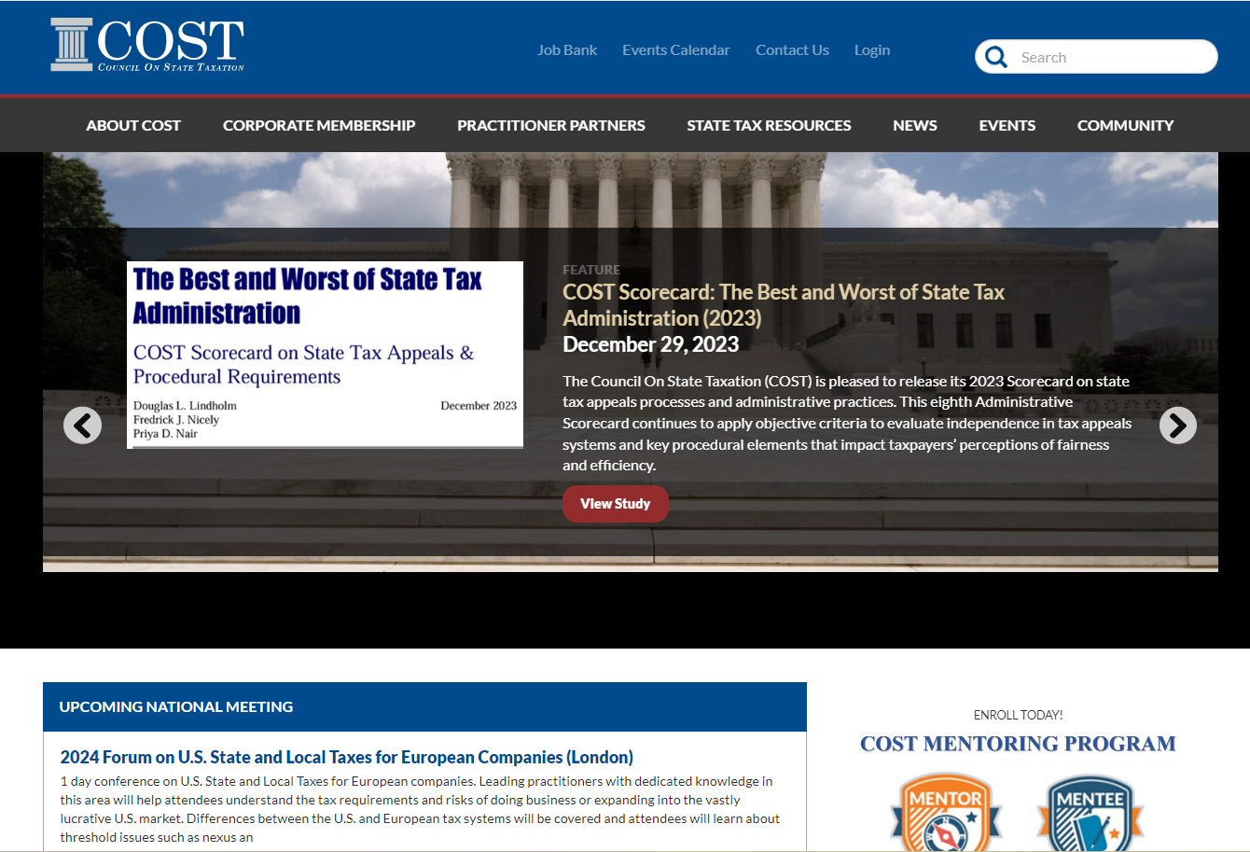

Slide 15

Benefits of Access to COST.ORG
Online Discussion Forums
Online Membership & Practitioner Directory
COST Conference Information, Agendas and Online Registration
State Tax Library, including COST Studies, Articles & Special Reports, Amicus Briefs, and State Tax Policy Reports
COST Practitioner Connection Articles
COST Publications
Job Bank
Advanced Search of Archived Materials

Slide 16
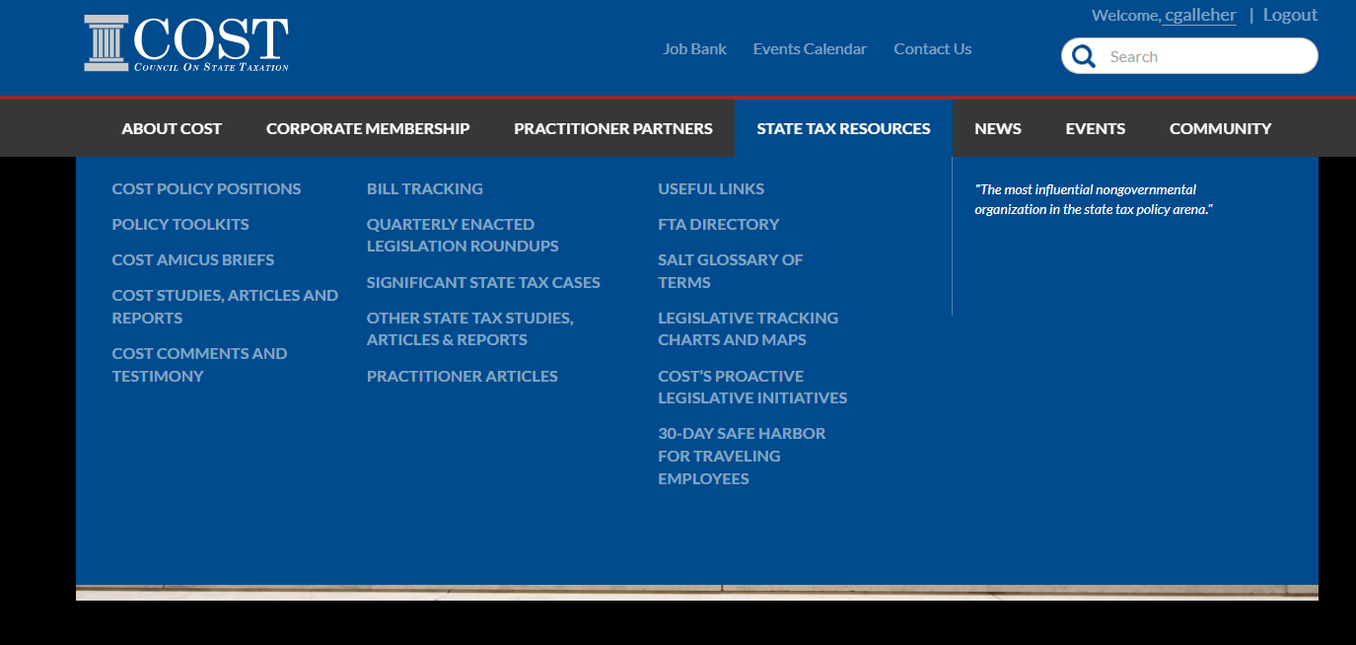

Slide 17
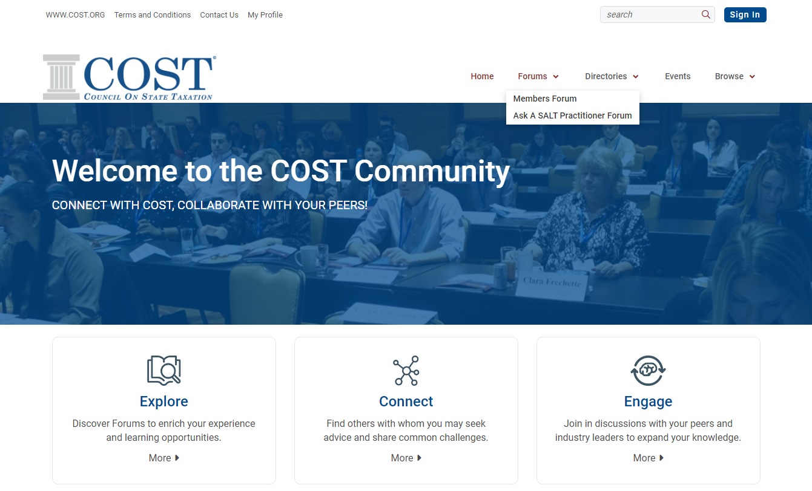

Slide 18
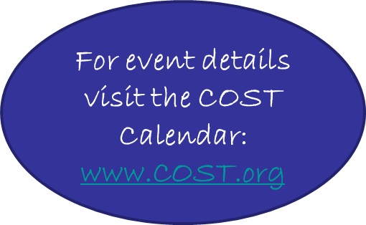
COST EVENTS
COST Hosts the following educational offerings:
Sales Tax Conference & Audit Session
Income Tax Conference & Spring Audit Session
SALT Basics School
Intermediate/Advanced State Income Tax School
Intermediate/Advanced Sales & Use Tax School
COST Forum U.S. Taxes for Canadian Companies
COST Forum U.S. Taxes for European Companies
State & Local Tax Workshop for Tech Industry
Property Tax Workshop
Canadian Taxes for U.S. Companies Workshop
Annual Meeting
Regional Meetings at Various Cities Throughout the Year
And coming soon…Tax specific live webinars throughout the Year

Slide 19

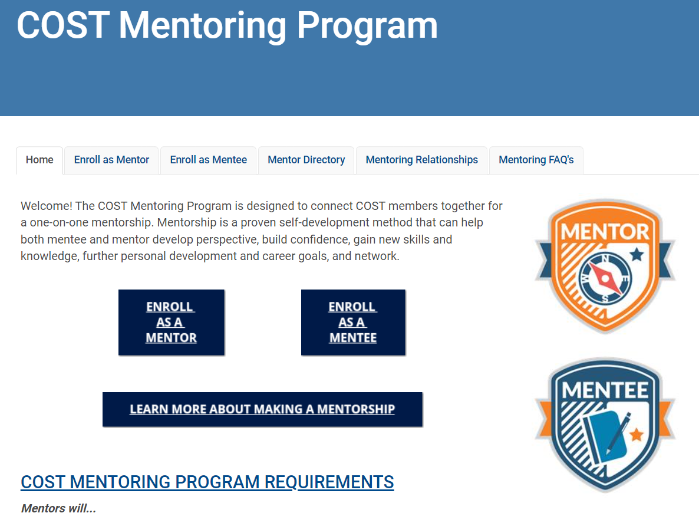
COST Mentoring Program
A unique networking and career development program that helps find, connect, and share experiences.
Open to COST corporate members only.

Slide 20

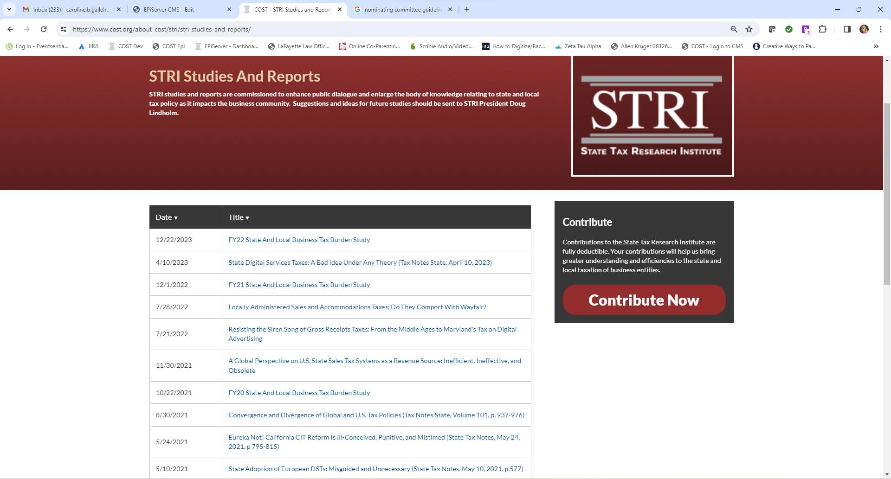
COST’s Foundation
A 501(c)(3) organization formed by COST in 2014 to conduct research designed to enhance public dialogue relating to state and local tax policy.

Slide 21
Research Paid Resources
Industry Sales Tax Solutions (ISTS) - www.industrysalestax.com
  State-by-state taxability matrix of software related transactions.
  DEMO
Law360 - https://www.law360.com/
  News and analysis on legal developments, many sales tax related news items

Slide 22
Research Paid Resources
Thomson Reuters Checkpoint - https://store.tax.thomsonreuters.com/accounting/Brand/RIA/c/3600
  Tax calculation package, rates, rules, audit database, exemption certificate management, research tools, forms, rate lookup tables, automatic rate update, address validation.
State Tax Notes - https://www.taxnotes.com/
  News and analysis on legal developments, many sales tax related news items, research tools
  DEMO
  2-week free trial

Slide 23
Technology Provider Tax Resources
Avalara – www.avalara.com
Sovos – www.sovos.com
Vertex - www.vertexinc.com
OneSource - www.onesourcetax.com
TaxCloud – www.taxcloud.com
TaxJar – www.taxjar.com
Additional Tax Software Resources: https://www.salestaxinstitute.com/resources/tax-software

Slide 24
Newsletter Subscriptions
Free
  Accounting Web
  AICPA
  CPA Practice Advisor
  Deloitte
  Eversheds
  KPMG
  McDermott
  SaltShaker
  Tax Foundation
  Vertex
Paid
  Accounting Today
  Bloomberg
  BNA
  Law360
  Tax Notes
  Journal of Accountancy
Google Alerts
  Sales tax
  South Dakota v. Wayfair
  Streamlined Sales and Use Tax
  Tax amnesty
  Tax holiday
  Use tax

Slide 25
Social Media
LinkedIn
  Groups
  Companies
  Individuals
Facebook
Twitter / X
Instagram
YouTube
Podcasts

Slide 26
Boolean Search Operators

Slide 27
Natural vs Boolean
Natural Language searching uses a relevance ranking to locate documents that are a good match your search terms.
  It uses a complex algorithm that takes into account factors such as the number of documents that include your search terms and the number of times those terms appear in each document.
Boolean Searching matches your search criteria exactly to documents in the collection.

Slide 28
Natural vs Boolean (cont.)
Use Natural Language when:
  Research is general or conceptual: Not specific
  Know only a few basic terms
  Only when you can’t come up with terms and connectors
So… use Boolean when you:
  Need precise results
  Know what you are looking for

Slide 29

Boolean Search Concepts
AND
Articles will contain mineral and deposit
Mineral
Deposit
OR
Articles will contain either mineral or ore
Mineral
Ore
NOT
Articles will contain mineral deposit but not mining
Mineral
Mining

Slide 30
Boolean Search Operators
Inclusion (AND): manufacturing AND exemption
Alternative (OR): manufacturing OR exemption
Exclusion (NOT): manufacturing NOT exemption
Exact phrase (“”): “manufacturing exemption”
None: manufacturing exemption guidelines – reads as AND

Slide 31
Boolean Search Operators (cont.)
Case sensitive exact phrase: ^”” - ^”IRS” or ^”ATI”
Combination searches: ( ) – “Trade Secrets” and (Discovery or Acquisition)
Single Character Wildcard: * - asterisk replace* one letter - fact* would find facts
Multiple Character Wildcard/Expander: ! – fact! Means factual or factor or facts or….

Slide 32
Boolean Search Operators (cont.)
Proximity: N/x or /x or W/x – Motion n/4 approve
Ordered Proximity: NP/x – Transcripts NP/5 Clerk
Sentence Proximity: S/ - tax s/ portfolio
Paragraph Proximity: “safe-harbor” p/ “capital expenses”
At least: ATLx: ATL5(safe harbor)
At Most: ATMx: ARM5 (safe harbor)

Slide 33
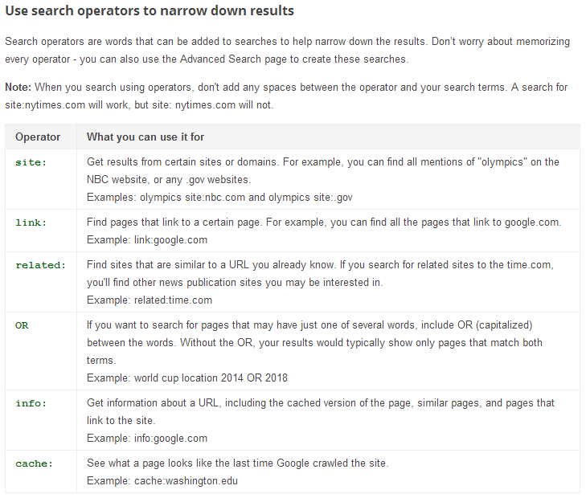
Boolean Searches in Google

Slide 34
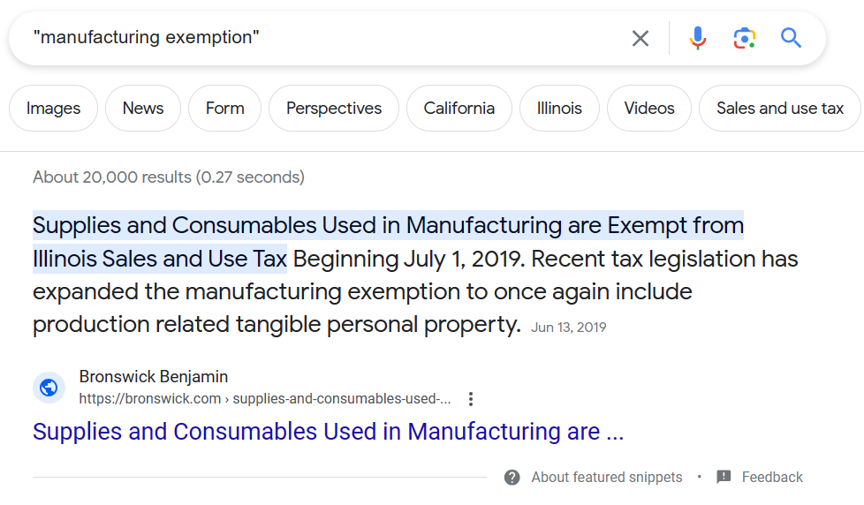
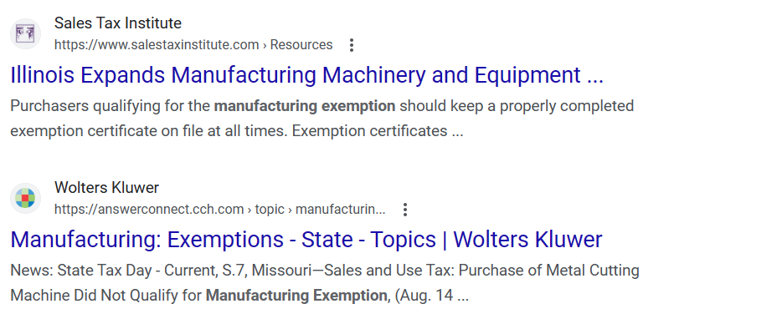
Boolean Search Example – “manufacturing exemption”

Slide 35
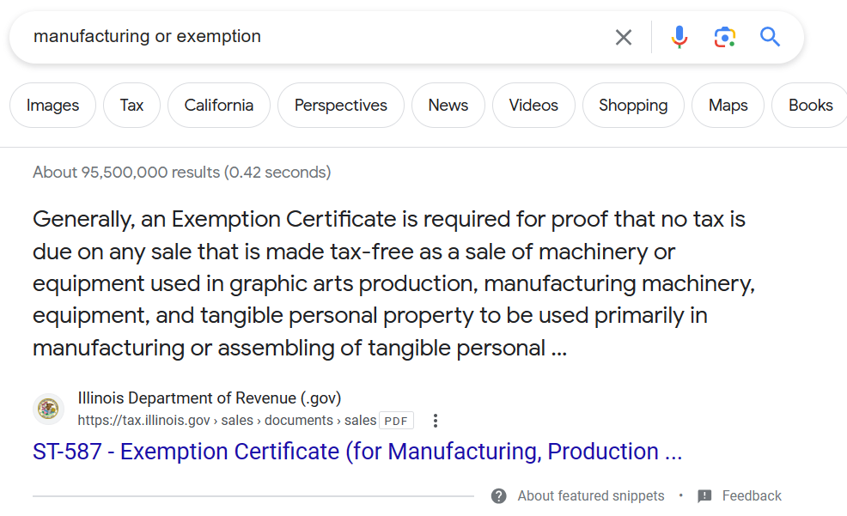
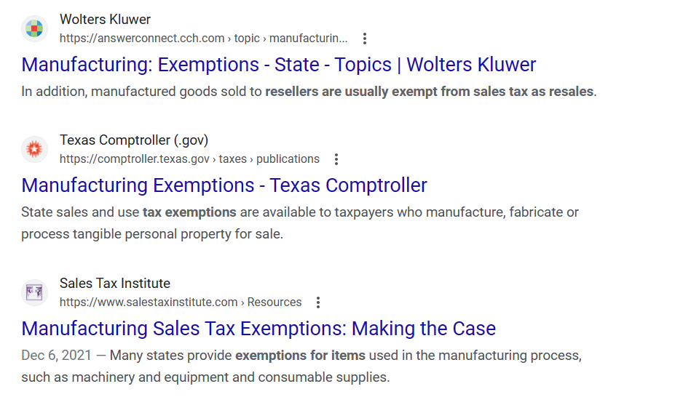
Boolean Search Example – manufacturing OR exemption

Slide 36
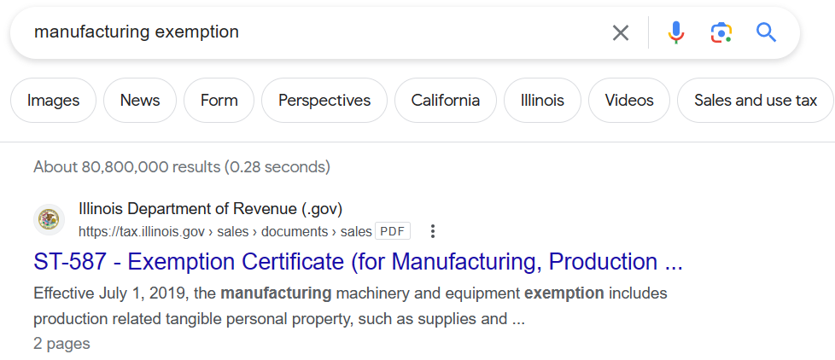
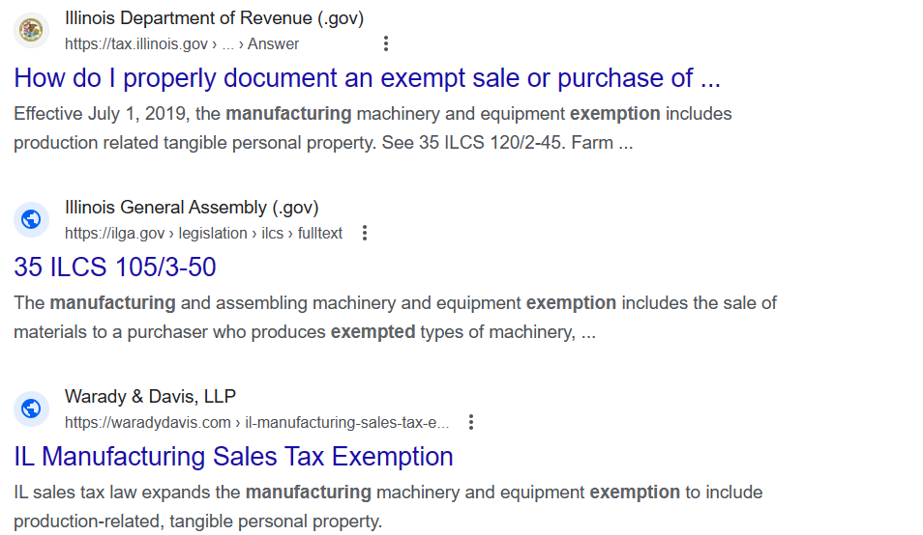
Boolean Search Example – manufacturing exemption

Slide 37
Technology/Data Resources

Slide 38
Technology/Data Resources
Excel
Microsoft Access
Power BI
SQL
Alteryx
Crystal Reports
Data warehouses
Internal software
AI Resources

Slide 39
Audit Resources

Slide 40
Audit Resources
Reviewing states that provide access to state audit manuals (such as Texas or Illinois) and looking for any remote audit protocol is an effective way to prepare for audits.

Slide 41
General Audit Manuals
California: https://www.cdtfa.ca.gov/taxes-and-fees/staxmanuals.htm
Idaho: https://tax.idaho.gov/wp-content/uploads/pubs/EPB00750/EPB00750_05-01-2019.pdf
Indiana: https://www.in.gov/dor/files/audit-manual.pdf
Massachusetts: https://www.mass.gov/doc/field-audit-procedures-manual-0/download
Michigan: https://www.michigan.gov/taxes/coll-audit/audit

Slide 42
General Audit Manuals
New Jersey: https://www.state.nj.us/treasury/taxation/pdf/njmap.pdf
Pennsylvania: https://www.revenue.pa.gov/TaxLawPoliciesBulletinsNotices/AuditManuals/Documents/sut_audit_manual.pdf
Texas: https://comptroller.texas.gov/taxes/audit/manuals/
Multistate Tax Commission: https://www.mtc.gov/audit/resource-documents/

Slide 43
Computer Audit Information
California (Computer Assisted Audit Brochure): https://www.cdtfa.ca.gov/formspubs/pub147.pdf
Illinois (Computer Assisted Audit): https://tax.illinois.gov/content/dam/soi/en/web/tax/research/publications/pubs/documents/pub-107.pdf
Louisiana (Computer Assisted Audit): http://revenue.louisiana.gov/Miscellaneous/caa%20brochure%20120108.pdf

Slide 44
Computer Audit Information
Missouri (Computer Assisted Audit Info): https://dor.mo.gov/taxation/business/audit/computer-assisted-audit-program.html
New York (Computer Assisted Audit): https://www.tax.ny.gov/pdf/publications/sales/pub132.pdf

Slide 45
Podcasts

Slide 46
Podcasts
TaxOps Saltovation
Peisner Johnson The SALTcast
Eversheds SALT Shaker
Women in Sales Tax
Sales Tax & More
KPMG – TWIST
EY Podcast
Cloud Accounting
Bloomberg Talking Tax
Oh My Fraud
Accounting Today

Slide 47
Networking Resources

Slide 48
Association/Membership Resources
Sales Tax Nerd Community - https://www.salestaxinstitute.com/sales-tax-nerd-community
CPA.com
COST (Council on State Taxation) – www.cost.org
IPT (Institute for Professionals in Taxation) – www.ipt.org
TEI (Tax Executives Institute) – www.tei.org
Taxpayer’s Federation of Illinois - www.illinoistax.org
Chicago Tax Club – www.thectc.org/
State and Local Chambers of Commerce
Industry Associations (Manufacturer’s Association, Retail Association)

Slide 49
Networking Resources
Sales Tax Institute
Sales Tax Nerd Community
LinkedIn
COST
IPT
Industry associations
Tax engine company conferences and events

Slide 50
Gaining Access to These Resources
Providing resources to your team
Asking your superiors for resources
Asking other departments in your company (legal, income tax, governance)
Complete the question on the course evaluation if you would like any of the listed vendors to contact you

Slide 51
Questions & Comments
Diane Yetter
Sales Tax Institute
diane@salestaxinstitute.com
312.701.1800, ext. 2

Slide 52
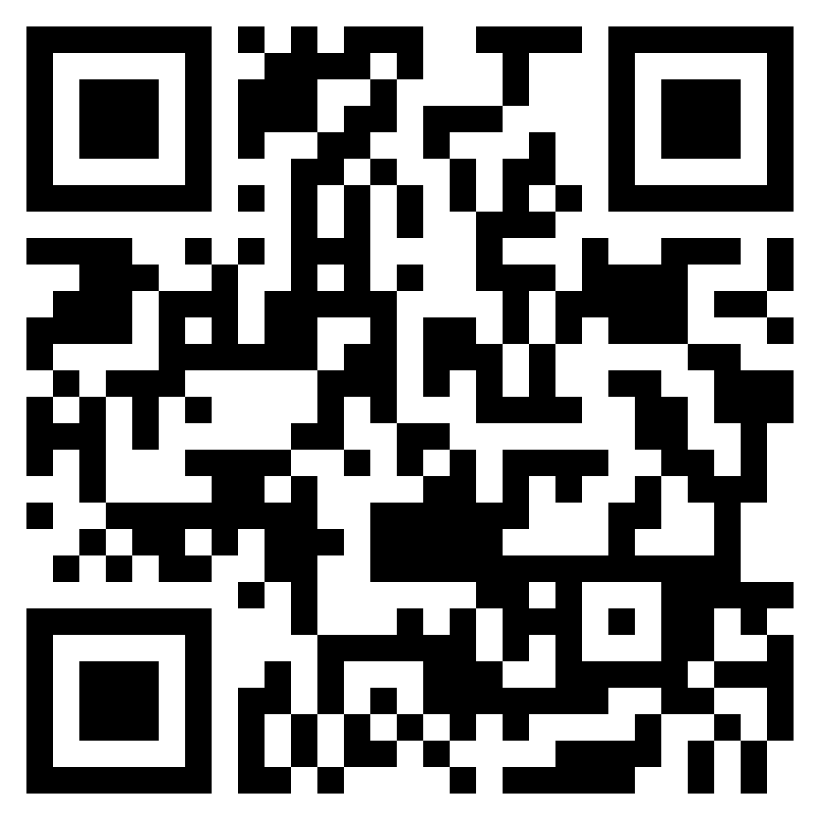
Sales Tax Institute Linked In Group
Join the Sales Tax Institute’s LinkedIn group, exclusively for Sales Tax Institute course attendees!
Post questions, ideas, practical suggestions and news updates that you think will be relevant to other Sales Tax Institute alumni.
We will be moderating the group, and we will remove inappropriate content posts so that this stays as a resource for our students to help them develop their sales tax expertise and ask questions.

Slide 53
On-Demand Webinars
New courses now available!
  Sales Tax Issues and Exciting Exemptions for Manufacturers
  Blueprint for Success: Sales Tax Essentials for Construction & Real Property
  Taxation of Rentals & Leases: Puzzle Solved!
  Use Tax Accrual for Automated and Manual Processes
  Software, Digital Goods, NFTs and Digital Currency: What You Need to Know for Sales Tax
  Registration Deep-Dive
  Compliance Deep Dive
  Sales Tax 101
  Administering the Sales Tax Function
  Drop Shipments: What Are They and What’s New Post-Wayfair?
  Great Exemption Adventure
  Sales Tax Challenges with Services – Freshly Updated!
  Starting a New Business or Initiative: What You Need to Know for Sales Tax
  Audit Empowerment: Techniques and Tips to Pass Your Next Audit
  Effective Tax Research

Slide 54
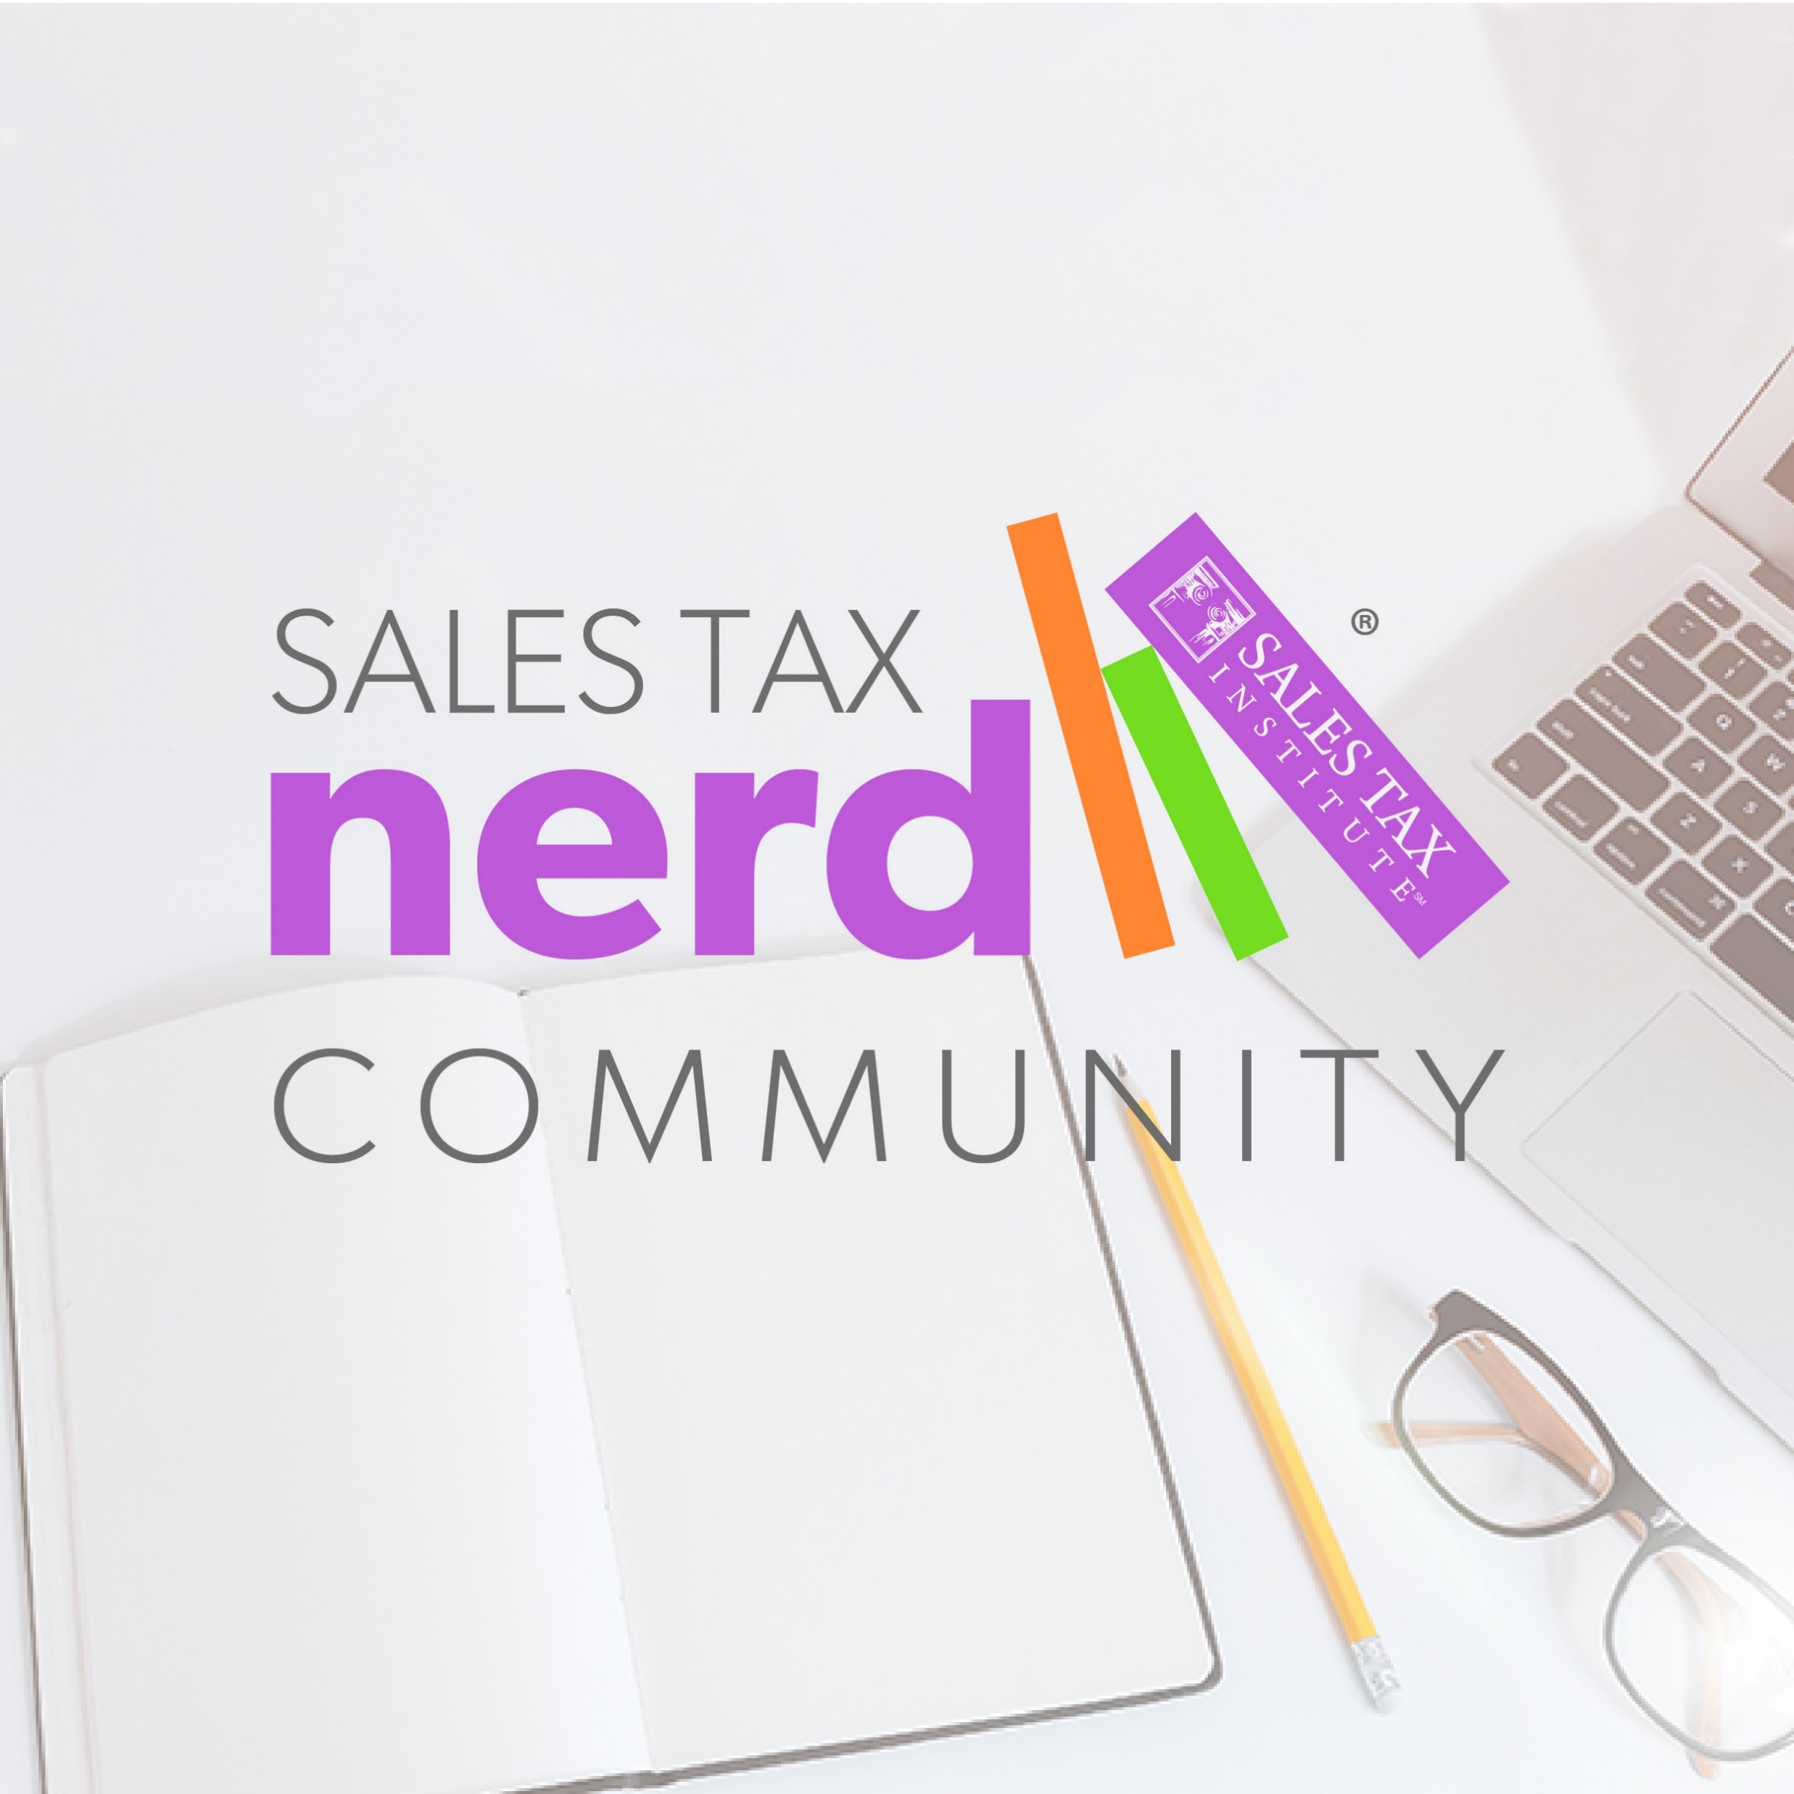






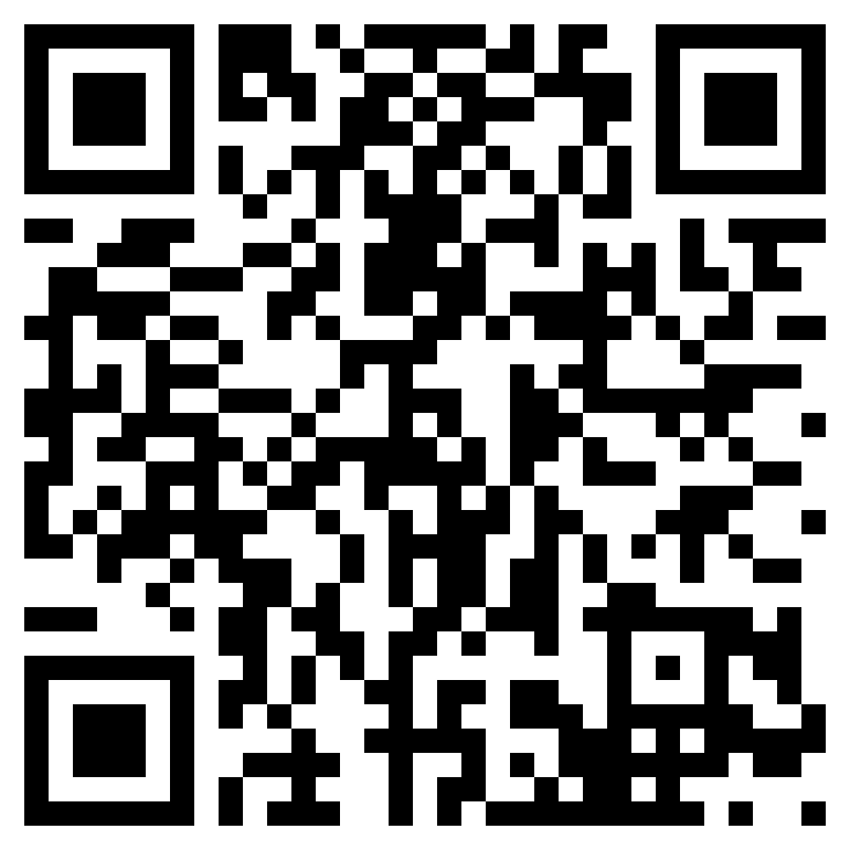
Sales Tax Nerd Community Membership
https://www.salestaxinstitute.com/sales-tax-nerd-community-membership
Save 10% with code WEBINAR10
Exclusive Online Platform to connect with Peers and STI
A year of live webinars and unlimited
on-demand webinars
Quarterly Office Hours with Diane
Sales Tax Tools Library
Course Discounts
Mentoring Program
….And much more!

Slide 55




Thanks to our Sponsors!

Slide 56




Thank you for watching!
/salestaxinstitute
Sales Tax Institute
910 W. Van Buren, Suite 100-321
Chicago, IL 60607
(312) 701-1800
/company/sales-tax-institute
/user/salestaxinstitute
webinars@salestaxinstitute.com
/salestaxinstitute/

