Slide 1
European Value Added Tax: What U.S. Sellers Need to Know
On-Demand Webinar

Slide 2

Founding Partner of terraVAT GmbH, which specializes in national and international VAT and customs law
Broad-based experience in International Indirect Taxation he gained as a member of the Indirect Tax teams of big-4 companies in Switzerland
Regularly publishes articles, teaches at the Swiss Trust School and speaks at seminars
Florian Hanslik,
Dr. in law, LL.M.,
DAS in VAT

Slide 3

Strategist, advisor, speaker, and author
President of YETTER
Founder of the Sales Tax Institute
Testified twice before Senate Finance Committee
IL CPA Society Women to Watch 2024
Accounting Today’s 100 Most Influential People in Accounting for 8 times between 2011 and 2022
Woman Business Owner of the Year 2020
Diane L. Yetter

Slide 4
Value Added Tax in the EU

Slide 5
EU Member States
Austria
Belgium
Bulgaria
Croatia
Cyprus
Czech Republic
Denmark
Estonia
Finland
France
Germany
Greece
Hungary
Ireland
Italy
Latvia
Lithuania
Luxembourg
Malta
The Netherlands
Poland
Portugal
Slovak Republic
Slovenia
Spain
Sweden
Romania

Slide 6
Framework of EU VAT
Some EU Directives
  1st Directive [67/227/EEC]
  2nd Directive [67/228EEC]
  6th Directive [77/388/EEC]
  7th Directive [94/5/EEC]
  8th Directive [79/1072/EEC]
  10th Directive [84/386/EEC]
  13th Directive [86/560/EEC]
  Council Directive 2006/112/EEC
The VAT system of the current 27 EU Member States are based on EC Directives
Part of the EC Directives have direct effect on local laws to give uniformity.
Parts of the EC Directives allow each country to implement the local country laws
Regulation(s)
  Council Implementing Regulation
  EU 282/2011

Slide 7
EU
VAT
Directive
EU VAT Implementation Provision
Local VAT Law
Local VAT Provisions
Local Administrative Instructions
ECJ case law
Hierarchy of EU VAT Regulations

Slide 8
Overview of Tax Structure

Slide 9
VAT – A Neutral Tax
A tax based on system of Collection, Netting and Remittance
VAT must be paid to the local tax authority (e.g. Finanzamt in Austria and Germany, ESTV in Switzerland and HM Revenue & Customs in the UK)
Businesses act like ‘tax collectors’ on behalf of the tax authority
Only meant to ‘stick’ with the end consumer of the goods or services and is not meant to build in costs for VAT registered businesses
VAT registered businesses are able to claim a credit for the VAT charged to them (Input VAT)

Slide 10
Advantages of the VAT System
Regular flow of income
Self-audit mechanism
Control of collection
Low collection costs
Collected on accrual basis
Input tax credit for all business inputs

Slide 11
Goods and Services
VAT treats goods and services differently. Therefore:
  Identification whether a supply of goods or services.
  Having identified the supply, determination of the place of supply.
  On cross border transactions, the place of supply will determine the VAT treatment.
Are these goods or services?
  Supply and install contracts
  Leasing
As per definition:
Goods
Services

Slide 12
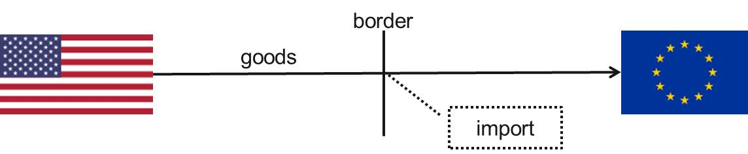
Example: Shipment of Goods by U.S. Company (1/2)
Scenario 1
  Sale of goods from the US to a customer in the EU.
  Incoterms e.g. DDP (Delivered, Duty Paid).
  EU VAT qualification: Import of goods from non-EU countries.
VAT implications of scenario 1
  US Company is importer of record and pays import VAT (plus customs / excise duty etc.).
  US company has to register for VAT in the EU and fulfill reporting obligations (VAT return, EC Sales Listing, Intrastat, etc.).
  US Company has to charge VAT on local supply to customer.

Slide 13
Example: Shipment of Goods by U.S. Company (2/2)
Scenario 2 - Simplification opportunities
  Incoterms (e.g. Ex Works, FCA (Free Carrier) or DAP (Delivered At Place)).
  Customer is importer of record.
VAT implications of scenario 2
  US company does not have to register for VAT in the EU.
  Customer pays import VAT and duties.
  US company does not have to charge VAT on supply to customer.
  US company has no VAT reporting obligations in the EU.

Slide 14
Manufacturer
Retailer
Sale pf goods
End customer
Sale of goods
1,000 + 200 VAT
3,000 + 600 VAT
Payment of
VAT 600
No recovery of VAT 600
Payment of VAT 200
Tax Authority
Tax Authority
Recovery of VAT 200
Transaction 1
  Supplier sells raw material to a Manufacturer for EUR 1,000 plus EUR 200 VAT
  Manufacturer pays EUR 1,200 to Supplier and recovers EUR 200 VAT from the Tax Authority.
Transaction 2
  Manufacturer supplies finished goods to a Retailer for EUR 3,000 plus EUR 600 VAT.
  Retailer pays to the Manufacturer EUR 3,600 and Manufacturer pays EUR 600 to the Tax Authority (EUR 600 – EUR 200).

Slide 15
Typical Treatments

Slide 16
Typical Treatment of Retailers
Retailers charge VAT on their sales and pay VAT on their purchases from their suppliers.
  Retailers can have a simplified scheme as opposed to tracking and calculating all of the sales.
  Pricing is VAT inclusive on B2C transactions.
  B2B transactions: VAT must be separately stated.

Slide 17
Typical Treatment of Manufacturers
Manufacturers charge VAT on the goods and services they provide, and they pay VAT on the inputs they purchases.
  In some jurisdictions, capital purchases for manufacturing are denied input tax credits.

Slide 18
Example: B2C - Supplies of Services Performed by U.S. Company
General VAT implications
  Relevance of the place of supply:
    Physical place of supply of the services mostly irrelevant
    From an EU VAT perspective, the cross border B2C supply of services should normally be taxed in the country where the supplier is located
    A US company supplying a service to an EU established consumer should not charge any VAT on the invoice.
    The US company is not required to register for VAT in the EU.

Slide 19
Typical Treatment of Service Providers (cont.)
B2C sales of electronic goods requires all sellers regardless of permanent establishment to register and collect VAT.
  EU simplified reporting options

Slide 20
Terminology

Slide 21
Nexus vs. Permanent Establishment
Sales Tax: Whether a company is required to collect sales or use tax is dependent on whether they have nexus with the ship to state.
  Nexus refers to links, connections, or contacts between a political jurisdiction and a taxpayer.
    Company owned property
    Company employees
    Company agents
    Economic presence
  If a taxpayer has sufficient nexus with a state, it is deemed to be “doing business” in that state and will be liable for the state taxes.

Slide 22
Nexus vs. Permanent Establishment (cont.)
VAT: A permanent establishment for VAT purposes is a factual inquiry. It could include:
  Having a facility located in the country
  Bookkeeping facilities located in the country
  Ability to enter into contracts

Slide 23
Resale vs. Input Tax Credit
Sales Tax: In every state, certain types of sales transactions are exempt from sales tax because of some characteristic of the buyer or seller
  Retail sales are sales to the end user/consumer and sales tax is due on the final sale of the property being sold.
  If you purchase items that you intend to resell prior to making any significant use of it, there is no sales tax due on your purchase.
  Purchasers claiming the resale exemption must provide a resale certificate to the seller.
  Only direct materials and inventory qualify for the resale exemption

Slide 24
Resale vs. Input Tax Credit (cont.)
VAT: An input tax credit is the input VAT the supplier has paid for its purchases
  The input tax credit is used to reduce the businesses overall tax liability
  Generally, businesses are required to track their purchases and retain key pieces of information such as invoices or customs documents.
  It is the suppliers’ obligation to validate the VAT number of its customer.
  Many (not all) business inputs are eligible for the input tax credit

Slide 25
Use Tax vs. Reverse Charge
Sales Tax: Use Tax acts as a complement to the sales tax. While sales tax is assessed upon the retail sale of tangible personal property, the use tax is generally assessed upon the storage, use, or consumption of tangible personal property purchased at retail and upon which no sales tax was paid.
  Paid after the sale

Slide 26
Use Tax vs. Reverse Charge (cont.)
VAT: In a reverse charge, the supplier no longer collects that tax and the requirement to collect and remit the tax shifts to the purchaser
  The purchaser accounts for both the input tax and the output tax
  Apply to B2B transactions particularly services by out of country providers

Slide 27
Exempt vs. Zero Rate
Sales Tax: In every state, certain types of items are exempt from sales tax based upon:
  The type of property being sold (food/clothing/medicines)
  The identity of the purchaser (Government/Nonprofit/Religious)
  The use of the property (Agricultural/Manufacturing)
  The purchaser is responsible for providing the seller the appropriate exemption certificate

Slide 28
Exempt vs. Zero Rate (cont.)
VAT: Exempt supplies are not eligible for input tax credits but zero rated are
  Supplier of exempt goods or services is not allowed to deduct VAT on the purchases and so purchasers could pay higher prices for these types of services
  Supplier of zero-rated goods or services does claim the input tax credit on business inputs, but a 0% rate applies on sales
  Common zero-rated supplies are food and exports

Slide 29
Make a “sale” vs. “supply”
Sales Tax: A sale is an event where goods or services are sold by a seller to the end user

Slide 30
Make a “sale” vs. “supply” (cont.)
VAT: A supply is an event where goods or services are provided by a seller to a recipient
  A taxable supply occurs when the seller makes a supply usually in the course of a business activity to a recipient
  Taxable supplies are those where VAT (even zero rated) applies

Slide 31
Make a “sale” vs. “supply” (cont.)
VAT
  Supplies of goods
  Supplies of services
  Economic ownership shall be transferred

Slide 32
Make a “sale” vs. “supply” (cont.)
VAT
  Value for tax purposes
    Goods or Services in EU – amount of money paid
    If not wholly in money, then value of consideration
    If between related entities, then “open market value”
    Must be local currency valuation

Slide 33
Place of Supply Rules
Issues:
  Inside the country
  Outside the country
  Deemed to be inside the country
Domestic Territory | Territory of an individual EU-Member State
EU Territory | Territory of the 27 EU-Member States
Non-EU Territory | Territory of the Non-EU-Member States

Slide 34
Place of Supply Rules (cont.)
Main rule: place of supply is the country where the transportation / dispatch of the goods begins.
If goods are not dispatched or transported, place of supply is the country where the goods physically are when the supply takes place.
Specialty
  When goods are installed or assembled: place of supply is the country where the installation / assembly takes place.

Slide 35
Goods and Services – Determination of Place of Supply
Regulations determining the place of supply:
CUSTOMER
OTHER
SUPPLIER
Place of supply can be with / where

Slide 36


Place of Supply of Goods (cont.)
Main rule: Place of supply is the country where the transport / dispatch of the goods begins.
goods
US
Spain
Place of supply
supplier
customer
No VAT implications for US company

Slide 37


Place of Supply of Goods
The place of supply is the country where the goods physically are when the supply takes place.
Place of supply
Hungary
goods
US
Austria
supplier
customer
Invoice: Hungarian VAT

Slide 38


Intra-Community Supplies
Goods shipped from one EU-Member State to another EU-Member State.
Place of supply, from where the goods are dispatched.
In principle, the Intra-Community Supply is zero-rated.
Supplier must however charge Italian VAT to customer if conditions for zero-rating not fulfilled.
Place of supply
Italy
Germany
goods
supplier
customer

Slide 39
Place of Supply of B2B Services
The ‘B2B’ (business-to-business) general rule for supplies of services is:
  The supply is made where the customer is domiciled.
  There are also ‘special’ exceptions for place of supply rules applying to certain services:
Services relating to land and property
Services relating to the short/long hire of transport
Services involving physical performance e.g. provision of educational, training, exhibitions, conferences, meetings, etc.
B2B supplies of admissions to these events
Certain intermediary services
Ancillary transport, valuation of / work on goods
Restaurant and catering services
Passenger transport
Supplies of telecommunications, TV, radio and broadcasting services
Electronically supplied services (such as downloadable services)

Slide 40
Services Performed by Non-EU Suppliers
When an EU company receives services from a non-EU based supplier, the invoice should not carry an EU VAT charge.
However, the supply may be subject to local taxes in the supplier’s country – this depends on the country’s tax system.
But, in most VAT and GST countries such as Norway, Switzerland, Russia, Australia and Canada, tax is not usually levied on services supplied outside of their country.
When an EU company receives the service, EU company should follow the general rule of reverse charge, which means the supply is taxed where the customer is based – the EU.
The invoice issued to EU company for the supply of intellectual and intangible services should be ‘VAT-free’, regardless of where the service is performed, even if that is in the EU.
The VAT due on this supply is accounted for by EU company via the reverse charge on the local EU VAT return.

Slide 41
E-Services

Slide 42
ESS - Electronically Supplied Services
Taxation of services provided via the internet and essentially automatic (minimal human intervention)
MOSS regulation as per Jan 1, 2015 (B2C): Place of supply is where the customer is located rather than where the supplier is located.
VAT liability with the first sale of ESS to a customer (no threshold)

Slide 43
ESS - Electronically Supplied Services
Non-EU Countries and their thresholds (May 2024)
Argentina (as per Jan 2018, nil)
Armenia (as per Jan 2018, AMD 15 million)
Australia (as per July 2017, AUD 75k)
Brazil (as per April 2018, nil)
Canada (as of July 2021, CAD 30,000)
Chile (as per Jun 2020, nil)
China (as per 2009, RMD 9,000 per transaction)
Ecuador (as per Sep 2020, nil)
Indonesia (as per August 2020, nil)
Japan (as per Oct 2015, JPY 10 million)
Kenya (as per March 2021, KES 5million)
Mexico (as per June 2020, nil)
New Zealand (as per Oct 2016, NZD 60,000)
Ukraine (as of Jan 2022, nil)
Saudi Arabia (as per Jan 2018, SAR 375,000)
Singapore (as per Jan 2020, SGP 100,000)
Switzerland (as per 2015, CHF 100,000)
Turkey (as per Jan 2018, nil)
UAE (as per Jan 2018, AED 375,000)
Uruguay (as per Jan 2018, nil)

Slide 44
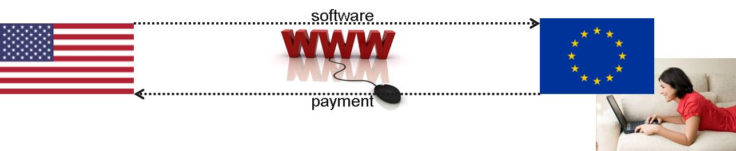
Example: B2C - Supply: Download of Software Supplied by U.S. Company (1/2)
US company is providing software solutions to consumers in the EU
Software can be downloaded via internet
EU VAT qualification: Electronically supplied services
VAT implications
  Obligation of US company to charge and account for VAT on sales in each and every country where the consumers are based
  US company must register for VAT (multiple VAT registrations). As of 1 January 2015, this also applies for EU companies.
Simplification
  ‘One stop shop’ available to avoid registration in each and every EU country (one VAT registration will work for all countries)

Slide 45

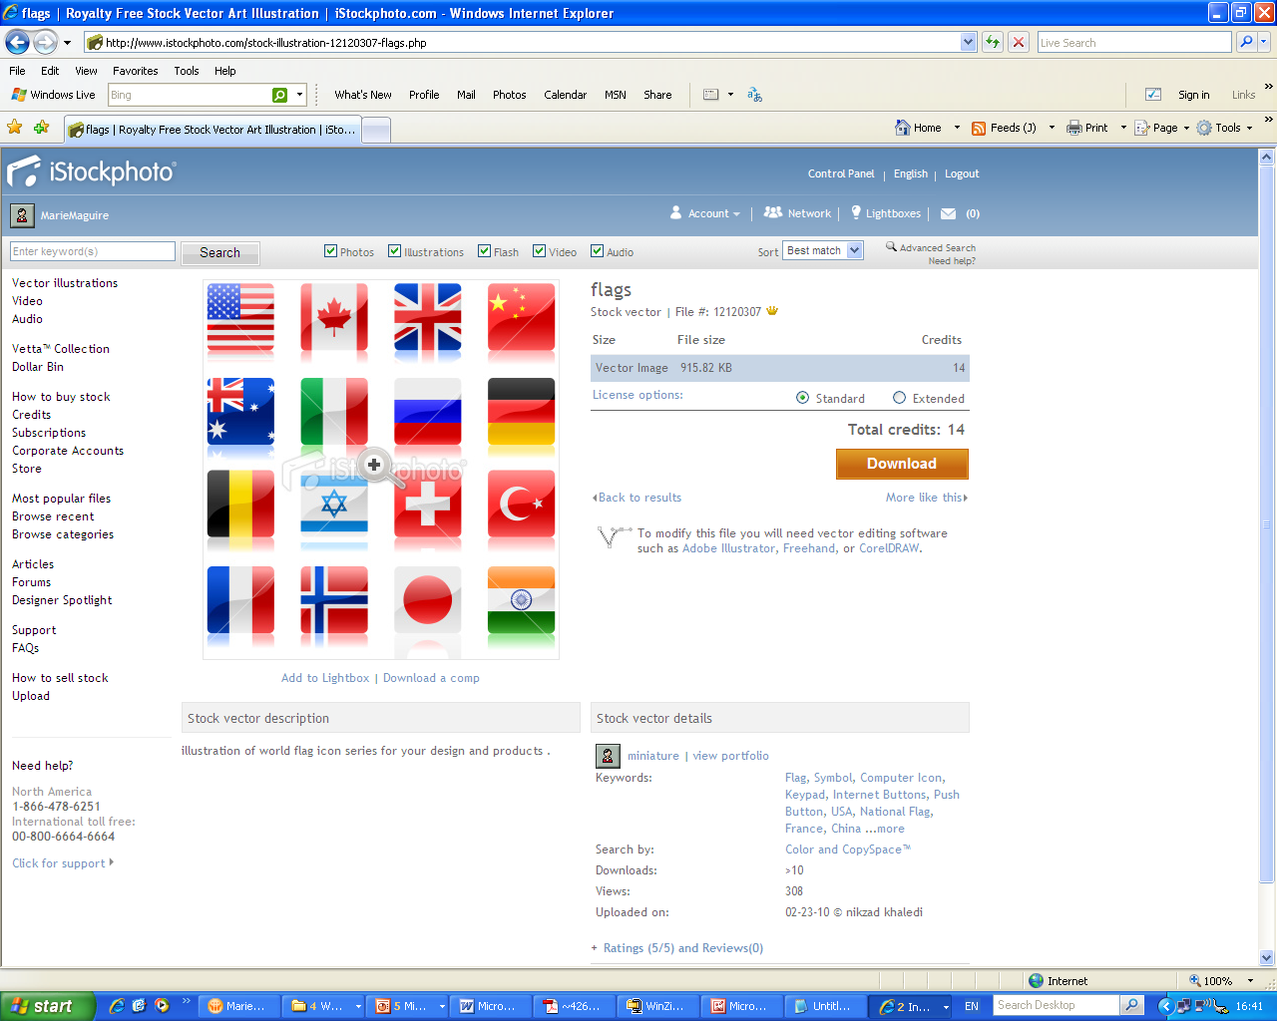


Example: B2C - Supply: Download of Software Supplied by U.S. Company (2/2)
USA
BE
DE
UK
CH
US supplier
Belgian B2C customer
Belgian VAT 21 %
German B2C customer
German VAT 19%
UK B2C customer
UK VAT 20%
Swiss B2C customer
Swiss VAT 8.1%

Slide 46
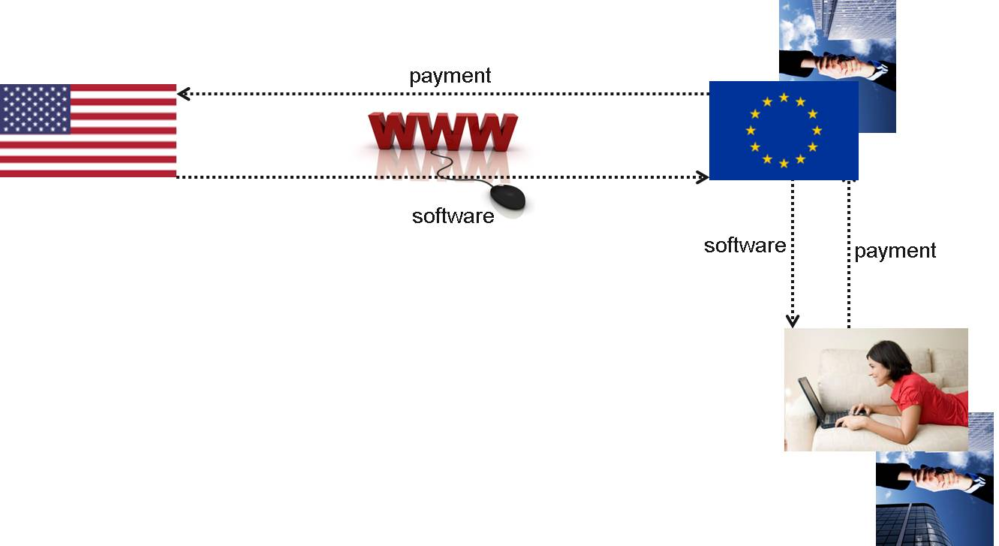
Example: B2B - Supply: Download of Software Supplied by U.S. Company
US company is providing software solutions to businesses in the EU and software can be downloaded via internet
EU business might later provide the same services to consumers / businesses worldwide
EU VAT qualification: Electronically supplied services
VAT implications
  VAT implications will be handled by the acquiring business in the EU under VAT reverse charge mechanism
  No obligation for the US supplier to register for VAT

Slide 47
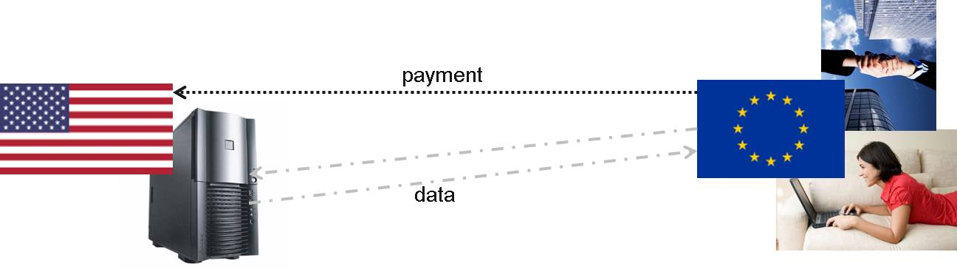
Example: Cloud Computing
US company is providing cloud computing services to customers in the EU (solution ‘plug into’ a cloud solution or utility computing model)
  EU VAT qualification: Electronically supplied services
VAT implications
  B2B: VAT implications will be handled by the acquiring business in the EU under VAT reverse charge mechanism (no obligation for the US supplier to register for VAT)
  B2C: Obligation of US company to charge and account for VAT in each and every country where the consumers are based (simplification with One Stop Shop available)

Slide 48
E-Commerce

Slide 49
Internet and E-Commerce VAT
Sales via the internet to European consumers is huge.
E-commerce is set to account for over 20% of retail selling in EU within a few years.
Responsibilities for retailers in terms of understand the VAT liabilities and charges in each EU state.
Failure to do so will leave any online retailer exposed to investigations and potential fines.
Businesses selling goods to consumers in other countries most likely will face an obligation to charge and collect local consumption taxes.

Slide 50
New Rules as of July 1, 2021
OSS and IOSS
Supplies within EU: New threshold for B2C supplies of more than EUR 10,000
For importations into the EU less than EUR 150 → no import VAT, but local VATable supply.
For importations into the EU more than EUR 150 → import VAT, local customer is liable for import VAT.
Monthly / quarterly returns

Slide 51
VAT & Marketplaces in the EU
When? - From 1 July 2021
Why? – Ensure effective collection of VAT, reducing administrative burden for suppliers and consumers
What changed? – The taxable person operating an electronic interface (a Market Place) will be deemed to be the supplier of goods in certain circumstances. In other words, the electronic interface will assume the VAT obligations of the underlying supplier when making certain sale of goods to customers where the interface facilitates the sale of the goods
Can you opt in or out of the new rules? – No – not optional
What if we ignore the rules? Penalties for non-compliance and potential VAT liability for the VAT that should have been charged to customers
51

Slide 52
What is an Electronic Interface?
It allows 2 independent systems and the customer to communicate with each other through the help of a device or program. This could be a website, platform, marketplace or something similar
Amazon is a prime example of Marketplace which is an Electronic Interface!
To be an electronic interface you need to facilitate the sale and supply of goods. Facilitates means:
  Directly/indirectly set any of the terms and conditions under which the supply is made
  Directly/indirectly involved in authorizing the charge to the customer
  Directly/indirectly involved in ordering or delivery of the goods
Only need to meet one of the above conditions
  Terms & Conditions
  Type of good
  Returns
  Guarantees
  Delivery
  Payment
  Charge to Customer
  Influence the following
  Whether the customer pays
  When the customer pays
  Method of payment
  Authorising payment
  Delivery of goods
  Doesn’t have to generate purchase order
  Instead influences the way in which goods are ordered or delivered
52

Slide 53
What is a deemed supplier?
First instance
If goods are imported from outside the EU (regardless of where underlying supplier is established), and
Have a value of under EUR 150 – includes costs of sale if not shown separately
Second instance
Supply of EU goods (goods already in circulation in the EU) by a taxable person who is not established in the EU to a non-taxable person, regardless of the value of that supply
If either of the above apply, then the Electronic Interface will be considered a deemed supplier and hence the new rules apply
The Electronic Interface can be a deemed supplier for some goods and not for others
53

Slide 54
Compliance Obligation
Compliance obligations
As a deemed supplier, the marketplace will take over the VAT implications of the underlying seller.
Market place will have to charge VAT on the sale of the good to the consumer
VAT rate will depend on where the consumer is located
Can either register for VAT in each member state or use the Import one stop shop – much the same system as currently using for commissions
54

Slide 55
Responsibilities of a deemed supplier
Keep records – description of goods, date of supply, taxable amount, VAT rate applied, currency used, date and amounts of payment, proof of returns, order number
Name, postal address, electronic address and website of the supplier and their VAT number and bank account number
Description of the goods, value, place where they were dispatched from and where the transport of goods end, time of the supply, order number
Important to note that this is required for all supplies, not just those where they are a deemed supplier
55

Slide 56
Implications of being a deemed supplier (1/2)
Concept of Joint and Several Liability
  Market places will be dependent on the underlying supplier to give them the correct information in order to fulfil all VAT obligations. For instance, marketplaces will need to know the nature of the goods and where they are being dispatched from
  If this information is incorrect then the authorities are within their rights to look for the under payment of VAT from the marketplaces
  Marketplaces are dependent on the 3rd party giving this information
  If the information is incorrect, marketplaces have to be able to demonstrate that they could not reasonably know the information received was incorrect
Burden of proof rests with the deemed supplier
56

Slide 57
Implications of being a deemed supplier (2/2)
  Burden of Proof – need to collect at least the following from underlying supplier:
  Place of establishment of supplier
  Description of goods
  Taxable amount
  Ship from location
  Information on returns of goods and cancelation amounts
  Due Commercial Care
  Concept various depending on size of electronic interface
  Care will depend on whether the interface has a fully automated solution for verification or not
  Other interfaces will have to preform random verification checks
  For instance – if no checks are being done then due commercial care not carried out and limited liability would not apply
  Examples of due care – communicated with underlying suppliers what information is required, requires underlying suppliers to upload this information to interface, reasonable verification checks set up, use data that might be available from else where on their systems to verify information
57

Slide 58
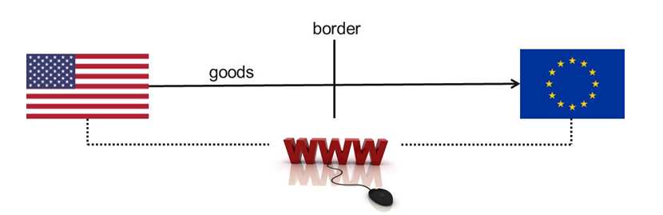
Example: B2C Transactions: E-Commerce
Selling goods supplied by U.S. Company (1/2)
Scenario 1
  Sale of goods via the internet / through a mail order catalogue.
  Incoterms: e.g. DDP → US Company is importer of record.
VAT implications of Scenario 1
  US company has to register for VAT in the EU (OSS / IOSS) and fulfill reporting obligations.

Slide 59
Example: B2C Transactions: E-Commerce
Selling goods supplied by U.S. Company (2/2)
Scenario 2 - Simplification opportunities
  Incoterms: e.g. DAP, FCA or Ex Works.
  Customer will act as importer of record.
  US Company does not have to register for VAT in the EU.
If goods are supplied from a warehouse of the US company located in the EU, US Company has to register for VAT!

Slide 60
Example: B2C Transactions: E-Commerce
Selling goods supplied by U.S. Company (2/2)
General VAT implications
  Relevance of the place of supply: Physical place of supply of the services mostly irrelevant (exemptions apply).
  The US company is not required to register for VAT in the EU.
  Certain exemptions apply for the above main rule, such as services related to immovable property.

Slide 61
Changes as of 2025

Slide 62
Important changes as of Jan 2025
With the digitalisation of the economy, increasing numbers of events, training sessions, and conferences are being organised in a virtual or hybrid manner.
New place of supply rules for events in a B2C context
For B2B context, nothing will change, no risk for the supplier
Place of supply will be where the non taxable person attending the event is established
Event businesses should assess the potential impact of these changes
  Registration requirements in different countries
  Exemption opportunities in other countries
  Using an existing OSS registration

Slide 63
Registration Requirements

Slide 64
Registration Requirements
In many jurisdictions, a supplier is required to register to collect and remit VAT when they exceed a certain threshold
  These thresholds can vary from as low as $30,000 in Canada to as high as S$1,000,000 ($800,000) in Singapore
  It is also possible to register voluntarily if these thresholds are not exceeded.
  Non-resident businesses can also be required to register for VAT. Other thresholds will then be decisive.

Slide 65
Registration Requirements
VAT periods vary from month to year
Fiscal representatives may be required similar to a registered agent in the US

Slide 66
Compliance Obligations

Slide 67
Compliance and Remittance
Compliance requirements vary widely between jurisdictions
  Some jurisdictions have simple VAT returns that only require information about total VAT collected and paid
  Others require detailed breakdowns by rate and type of transaction
  All European Union member states require separate filings for sales lists and INTRASTAT

Slide 68
SAF-T – the Standard Audit File – Tax
The goal of SAF-T is to produce a standardized format for electronic exchange of accounting data from organizations to their national tax authority and external auditors.
The two key principles behind SAF-T are:
  Organizations should be able to export information from their accounting systems (invoices, payments, general ledger journals and master files) into a standardized format and
  Tax authorities and external auditors should be able to make their tax inspections and audits more efficient and effective as a result of data being made available to them in that standardized format.
3 different approaches:
  Data to be provided at the request of the tax authority (usually prior to a tax inspection or audit)
  Submission of data periodically in addition to the periodic VAT return
  Submission of transactional data as a replacement to the periodic VAT return

Slide 69
SAF-T – the Standard Audit File – Tax
Where are we now?
Portugal
  One of the first adopters
  Since 2008 on an annual basis
Luxembourg
  Introduction in 2011
  It only applies to Luxembourg resident companies
  It is only required to be submitted when requested by the tax authority
France
  France introduced a SAF-T requirement in 2014
  It is only required to be filed on demand when requested by the French tax authority
Austria
  Austria introduced SAF-T in 2009
  It is only required on demand when requested by the tax authority

Slide 70
SAF-T – the Standard Audit File – Tax
Where are we now?
Poland
  For larger companies, a monthly filing
  Since 2016
Lithuania
  Lithuania introduced on a phased basis, starting with the largest organizations in 2016 and is now mandatory for all businesses
Norway
  SAF-T has been in place on a voluntary basis since 2017
  ‘on-demand’ basis from January 2020
  Obligatory as of January 2022

Slide 71
E-Invoicing in Europe
Poland
  The national e-invoicing system, called Krajowy System e-Faktur (KSeF)
  KSeF became available on a voluntary basis from the start of 2022.
  KSeF will become mandatory from Feb 2026. Until then, paper and PDF invoices are still acceptable.
Romania
  The national e-invoicing system, called RO-eFactura
  As of July 1, 2024. RO-eFactura will become mandatory.
France – delayed, originally scheduled for July 2024, delayed to September 2026
Germany – delayed until 2028
Hungary – as of 2018, RTIR live invoice reporting, as of Jan 2024, e-VAT pre-filled returns based on live invoicing reporting
Spain – slightly delayed, delayed until July 2025, B2G in place as per 2015
Belgium delayed to Jan 2026
EU – 2030 – 2035: Digital reporting and e-invoicing harmonization

Slide 72
VAT Recovery

Slide 73
Input VAT Recovery
The taxable person’s right to deduct input VAT incurred on goods and services specifically used to make taxable supplies
Deduction of the input VAT from the output VAT payable on his supplies
A taxable person can also deduct input VAT if he/she performs economic activities in another country that would create a right of deduction if they were performed within that country
Where the amount of deductions exceeds the amount of tax due, Member States may make either a refund or carry the excess forward to the following period according to conditions which they shall determine
Formal invoicing requirements within the respective Member State should be reviewed

Slide 74
Input VAT Recovery
Input VAT on
  Supplies of goods or service, carried out by another person
  Intra-Community Acquisitions
  Importation
  Reverse charges
Restrictions
  Supply of goods/services exempt without credit
  Mixed supplies
  Private use, gifts
  Member State specific regulations & proportional deduction
Proof with a VAT invoice
  Where a taxable person no longer holds the original invoice, Member States may allow him to produce other evidence that the transaction in respect of which the deduction is claimed actually took place

Slide 75
Final Remarks

Slide 76
VAT is Important…
Making errors can be expensive (e.g. Interest charges and penalties).
VAT can result in higher costs being incurred with knock on effects for business margins and profits, in case it is handled incorrectly.
Not considering VAT on costs which cannot be reclaimed when setting prices could lead to loss-making products.
Charging VAT on a sale because the required evidence for zero-rating has not been obtained could put the business at a competitive disadvantage.
Not considering VAT requirements at the time of designing and implementing new accounting and billing systems can lead to higher costs if subsequent changes are required to meet VAT requirements.

Slide 77
Questions & Comments
Florian Hanslik
terraVAT GmbH
florian.hanslik@terravat.com
+41 44 515 70 19
Diane Yetter
Sales Tax Institute
diane@salestaxinstitute.com
312.701.1800, ext. 2

Slide 78
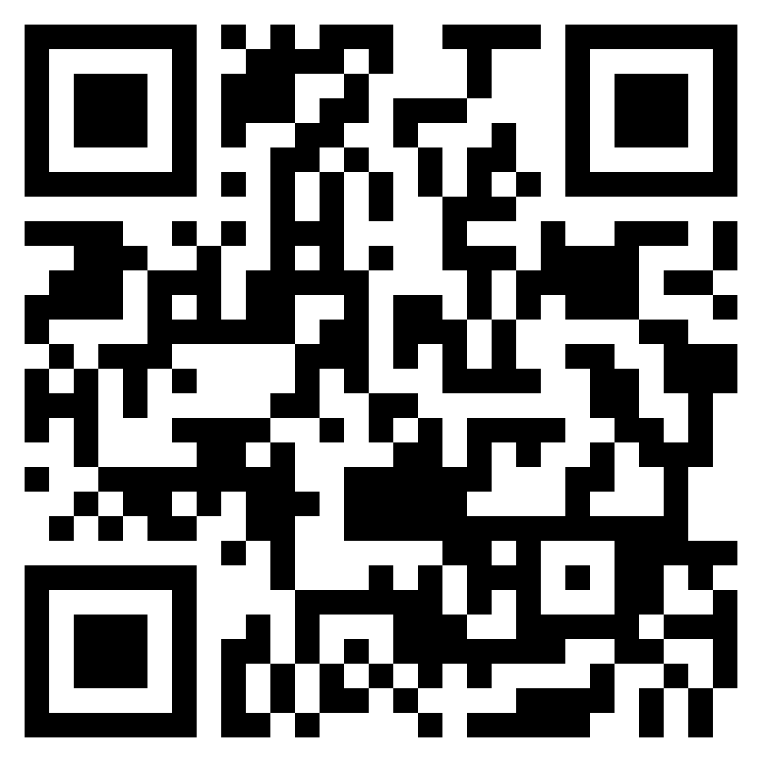
Sales Tax Institute Linked In Group
Join the Sales Tax Institute’s LinkedIn group, exclusively for Sales Tax Institute course attendees!
Post questions, ideas, practical suggestions and news updates that you think will be relevant to other Sales Tax Institute alumni.
We will be moderating the group, and we will remove inappropriate content posts so that this stays as a resource for our students to help them develop their sales tax expertise and ask questions.

Slide 79
On-Demand Webinars
New courses now available! – Including 2 new Bundles!
  NEW! Gross Receipts Tax: What Makes Them Special
  Simplifying Sales Tax for E-Commerce: Guidance for Sellers and Marketplaces
  Sales Tax Issues and Exciting Exemptions for Manufacturers
  Blueprint for Success: Sales Tax Essentials for Construction & Real Property
  Taxation of Rentals & Leases: Puzzle Solved!
  Use Tax Accrual for Automated and Manual Processes
  Software, Digital Goods, NFTs and Digital Currency: What You Need to Know for Sales Tax
  Registration Deep-Dive
  Compliance Deep Dive
  Sales Tax 101
  Administering the Sales Tax Function
  Drop Shipments: What Are They and What’s New Post-Wayfair?
  Great Exemption Adventure
  Sales Tax Challenges with Services – Freshly Updated!
  Starting a New Business or Initiative: What You Need to Know for Sales Tax
  Audit Empowerment: Techniques and Tips to Pass Your Next Audit
  Effective Tax Research

Slide 80







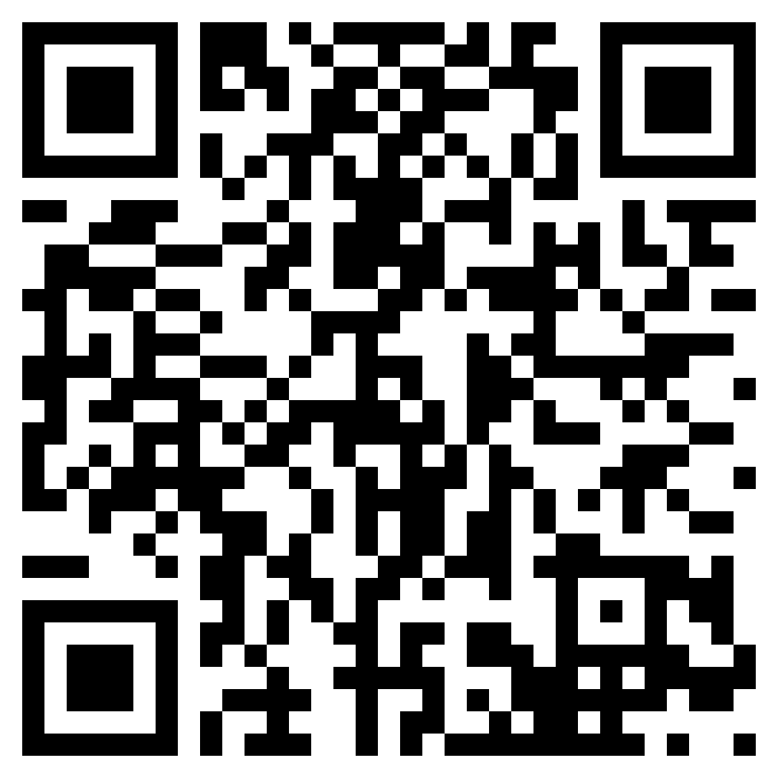
Sales Tax Nerd Community Membership
https://www.salestaxinstitute.com/sales-tax-nerd-community-membership
Save 10% with code WEBINAR10
Exclusive Online Platform to connect with Peers and STI
A year of live webinars and unlimited
on-demand webinars
Quarterly Office Hours with Diane
Sales Tax Tools Library
Course Discounts
Mentoring Program
….And much more!

Slide 81




Thanks to our Sponsors!

Slide 82




Thank you for watching!
/salestaxinstitute
Sales Tax Institute
910 W. Van Buren, Suite 100-321
Chicago, IL 60607
(312) 701-1800
/company/sales-tax-institute
/user/salestaxinstitute
webinars@salestaxinstitute.com
/salestaxinstitute/

