Slide 1
Finding the Right Sales Tax Software for Your Needs
On Demand Webinar

Slide 2

Strategist, advisor, speaker, and author
President of YETTER
Founder of the Sales Tax Institute
Testified before Senate Finance Committee
IL CPA Society Women to Watch 2024
Accounting Today’s 100 Most Influential People in Accounting for 8 times between 2011 and 2022
Woman Business Owner of the Year 2020
Diane L. Yetter

Slide 3
Do You Need a System?

Slide 4

Do You Need a System?
Before deciding to automate your indirect tax function, you should take a good look at your operations and ask a few questions to determine if an automated solution is actually necessary.

Slide 5
Do You Need a System?
If you make 100% of your sales through a marketplace facilitator (e.g. Amazon), then you probably don’t need a tax calculation system and you may not need compliance at all.
If you are using a website platform like Shopify that can’t integrate to a tax engine, you don’t need a tax engine. However, you probably do need a compliance solution.
If all your sales are exempt, you may not need a tax engine, but you’ll likely need an exemption certificate solution.

Slide 6
Solution Analysis

Slide 7

Steps of a Solution Analysis
Identify Team Members
Gather and Define Requirements
Determine type of solutions needed
Research potential vendors
Prepare a Request for Proposal (RFP) including demo scenarios
Prepare evaluation criteria
Conduct Demos
Review scoring and make selection

Slide 8
Project Planning – Team Members
Tax Department
Accounting Department
Accounts Payable Department
Accounts Receivable Department
Customer Service Department
Order Entry Department
Information Systems Department

Slide 9

Gather and Define Requirements
Tax Requirements
Business Requirements
Technology Requirements
BONUS TOOL: Vendor Selection - Key Criteria for Making a Decision

Slide 10
Vendors Evaluation
Number of vendors that provide tools with differing capability levels
Evaluate the interaction and ease of integration between solutions if selecting different vendors.
A comprehensive evaluation should include vendor demonstrations using representative data of your business.
Requirements may significantly limit vendor options.

Slide 11
RFP Process
Try to avoid minimum number of vendor requirements.
Watch how much you ask for in the RFP in relation to your project complexity and spend.
Be careful about asking for written details on your demo scenarios in advance.
Schedule enough time.
Know your evaluation criteria and run your RFP to evaluate it.
Who has the final decision internally?
Be fair but be tough to be sure you get the right solution.

Slide 12
Which System is Best for Your Needs?

Slide 13

Making the Decision
Breadth of connections that system can connect to
What platforms/language are supported?
What add-on tools are available?
Standard/Certified integration
SST CSP certification
Avalara has the most integrations.

Slide 14
Making the Decision
Sovos, Thomson Reuters and Vertex offer the most comprehensive tax solutions.
Most cloud solutions may not be as robust.
There are limitations in the cloud products in the ability to create custom content, custom tax authorities and to configure complex tax rules which require multiple data points.
Given that these providers are focused on the SMB market and in particular with e-commerce solutions and vendors, the simpler functionality was developed to ease concerns about usage.

Slide 15
Making the Decision (cont.)
Sellers of tangible goods are the target industry for these providers and in most situations, the functionality is sufficient.
Sellers of digital goods and services may require more robust functionality.
Vendors such as Avalara and CCH have acquired smaller niche providers of tax engines that focus on specialty taxes such as lodging, telecommunication and for VAT needs. This has expanded their ability to service broader requirements.

Slide 16
Making the Decision (cont.)
Traditionally Enterprise solution providers have come to market with hosted SMB options (Vertex Cloud, Sovos Taxify)
Consider all your needs and whether a variety of solutions is better or if one provider can solve all your needs.

Slide 17

Making the Decision (cont.)
Jurisdictions
  U.S.
  North America
  Global
Tax Types
  Sales/Use
  Utilities/Telecommunications
  Hospitality
  Leasing
  Other

Slide 18
Making the Decision (cont.)
Pricing Models
  Per user/server
  Revenue based subscriptions
  Transaction based subscriptions

Slide 19
Types of Systems

Slide 20
Types of Systems
Host systems
  Most sales or billing systems include some level of tax processing capabilities.
  Use of standard functionality depends largely on effort and user proficiency.
  Product taxability indicators are often insufficient.
  Customer taxability indicators are typically tied to single address.
  Procurement systems generally include limited tax functionality.

Slide 21
Types of Systems (cont.)
Host systems
  Best suited for
    Businesses with limited nexus or selling items taxed consistently across all jurisdiction
    Could be used for global taxation
  Not suited for businesses with broad nexus or varied taxability
  Typical for some e-commerce shopping carts

Slide 22

Types of Systems (cont.)
Bolt-on products on premise
  Offer more sophisticated tax processing
  Interface required to communicate between host system and bolt-on package
  Often requires customization to host system or interface to achieve desired level of functionality
  User training may impact effectiveness of any tax package

Slide 23
Types of Systems (cont.)
Bolt-on products
  Best suited for larger businesses with complex taxability or broad nexus
  Not suited for small businesses that can’t support the infrastructure
  Traditional on-premise providers also offer hosted options

Slide 24

Types of Systems (cont.)
Bolt On Cloud/ASP Hosted Systems
  An off-premise solution
  Provider manages all updates and provides the infrastructure
  Arrange for access to the tax data
  Typically are not as customizable as a full software implementation, but allow for easy scalability

Slide 25
Types of Systems (cont.)
Bolt On Cloud/ASP Hosted Systems
  Best suited for e-commerce and other smaller businesses without sophisticated tax requirements
  May not be suitable for all companies due to either confidentiality/firewall issues or processing speed and volume of transactions

Slide 26

Types of Systems (cont.)
Custom designed systems
  Often incorporated into custom billing systems
  Unusual tax requirements or non-standard sales tax rate require high levels of customization
  Wholly custom systems are difficult to maintain

Slide 27
Types of Systems (cont.)
Custom designed systems
  Longstanding systems usually have become more sophisticated and accurate
  Third party rate packages can be incorporated into custom calculations
  Replace custom tax functionality with canned programs

Slide 28

Types of Systems (cont.)
Custom designed systems
  Best suited for companies in industries with unusual tax requirements or non-standard sales tax rates such as food, medicine, telecommunications and utilities
  Not suited for companies without sophisticated IT and Tax expertise

Slide 29
Types of Systems (cont.)
Non-Interactive Solutions
  Simplistic and require manual updating
  Excel and Access can be used to build templates that can incorporate rules for calculating tax
  Tax rules and rates must be maintained manually
  A hybrid solution is sometimes required to address multiple methods of invoice generation

Slide 30
Types of Systems (cont.)
Non-Interactive Solutions
  Best suited for companies that have limited billing systems that cannot interface with a standard third-party tax package or very low volume of transactions
  Not suited for high volume or businesses with many billing personnel

Slide 31
System Integrating with Tax

Slide 32
ERP Systems
Enterprise Class On Premise and Cloud Options
  SAP
  Oracle
Mid Class Cloud
  Netsuite
  Microsoft Dynamics
SMB Cloud
  Sage
  Quickbooks

Slide 33
Retail Systems
Point of Sale (POS)
Ecommerce
  Magento
  Shopify
  WooCommerce
Marketplace - Web portal
  Amazon
  Ebay

Slide 34
Other Systems
eProcurement
  Ariba
P-Card
PO Systems
Expense Reporting
CRM

Slide 35
Tax Functional Solutions

Slide 36

Sales and Use Tax Calculation Tools
Rate automation tools
  Systematically maintain and apply tax rates
  Should include:
    Different tax types
    Rates and ability to identify intrastate vs interstate transactions
    Maximum tax rules for jurisdictional limits
    Geographic linkage to rates
  Monthly updates to accommodate rate changes
  Rate tools are generally included with a tax calculation product

Slide 37
Sales and Use Tax Calculation Tools (cont.)
Sales tax calculation automation tools
  Work in conjunction with billing or order entry systems
  Product offerings differ depending on host system platform
  Interface required for communication
  Standard interfaces usually available
  Tax calculation tools often have more functionality than the host systems

Slide 38

Sales and Use Tax Calculation Tools (cont.)
Procurement tax calculation automation tools
  Sales tax calculation tools for procurement systems
  Should accommodate differences from sales tax interface to include different data types
  Procurement tax determination more difficult than sales tax
  Real time and batch solutions
  P-cards, EDI, ERS and data file uploads raise additional challenges

Slide 39
Sales and Use Tax Calculation Tools (cont.)
Procurement tax calculation automation tools issues
  Verification and processing of vendor charged tax
  Accurate ship-from vendor address
  Vendor paid tax for one level and self asses another
  Accurate product identification information
  Identify usage of mixed taxability items
  Tax determination of internal usage
  Tax determination on temporary storage items

Slide 40
Sales & Use Tax Compliance Tools
Compliance challenges
  Determine, report and remit tax liabilities
  Returns filed timely on acceptable medium
  Sales and use tax returns due within a 10-day period
  Most taxpayers required to file electronically
  Some states accept only state provided forms

Slide 41

Sales & Use Tax Compliance Tools (cont.)
Custom Templates
  Excel or Word to generate returns
  Often created prior to forms packages availability
  Some very sophisticated and can produce returns
  Others may generate data which is manually populated into returns

Slide 42
Sales & Use Tax Compliance Tools (cont.)
Custom template risks:
  Maintenance and updates for rate and form changes
  Filing custom generated forms without obtaining state’s approval
  Training new personnel

Slide 43
Sales & Use Tax Compliance Tools (cont.)
Forms packages
  Blank forms more limited availability
  Vendor provided forms packages
  Sometimes State provided forms required
  Some electronic forms allow entry but do not calculate

Slide 44
Sales & Use Tax Compliance Tools (cont.)
Calculating forms
  Provides for entry of information with formula functionality
  Calculating forms automatically determine amounts for dependent fields
  State acceptance of forms

Slide 45
Sales & Use Tax Compliance Tools (cont.)
Interactive download forms
  Capable of importing data from calculation systems
  Vendors provide interface from calculation system to returns file
  Packages generally include forms for all states
  Capable of creating bar codes and other taxpayer identification
  Many packages allow an import of third-party tax data

Slide 46
Exemption Certificate Management Tools
Forms packages
  Blank exemption certificate forms obtainable from a number of sources
  Available from states websites or other sources
  Multi-jurisdictional or state specific forms depending on state
  Electronic forms packages provide entry capability

Slide 47

Exemption Certificate Management Tools (cont.)
Validation packages
  Scanning and “validation” capability
  Information uploaded from scanned document
  Significant reporting functionality
  Interface to tax calculation packages
  Data will need to be interfaced either through an interface or by an additional manual entry process

Slide 48
Exemption Certificate Management Tools (cont.)
Calculation system interactive packages
  Most tax calculation packages include exemption certificate entry capability
  Ability to cross reference to a scanned certificate
  Limited reporting capabilities
  Many of the calculation systems have validation packages as an additional product offering

Slide 49

Exemption Certificate Management Tools (cont.)
Hosted and Service Solutions
  Some providers offer a service component where they will manage the request, renewal and approval processes
  Application is usually hosted and maintained on the provider’s servers
  Customer accesses the software remotely
  Application can be accessed from any location with network access

Slide 50
Reporting Tools
Most companies have some sort of reporting tool available that they use to create financial reports
The major tax calculation systems now offer more sophisticated reporting tools
The major tax calculation systems have also separated their database into two pieces, the production (live) transaction database and then a separate reporting database

Slide 51
Data Management Tools
Data Warehouse applications
  Appropriate information in financial data warehouse for sales tax?
  Ensure sufficient level of detail of data is migrated into the data warehouse

Slide 52

Data Management Tools (cont.)
The tax calculation package audit database may be able to function as a tax data warehouse
Specialized tools to assist in managing the transaction tax function

Slide 53
Managed Tax Services
Combined calculation and compliance “service” offering
Offer more software at more affordable prices than enterprise solutions
Hosted by provider
Billing system connects to hosted solution
Compliance similar to outsourced solution

Slide 54
Sales Tax Automation Vendor Chart

Slide 55
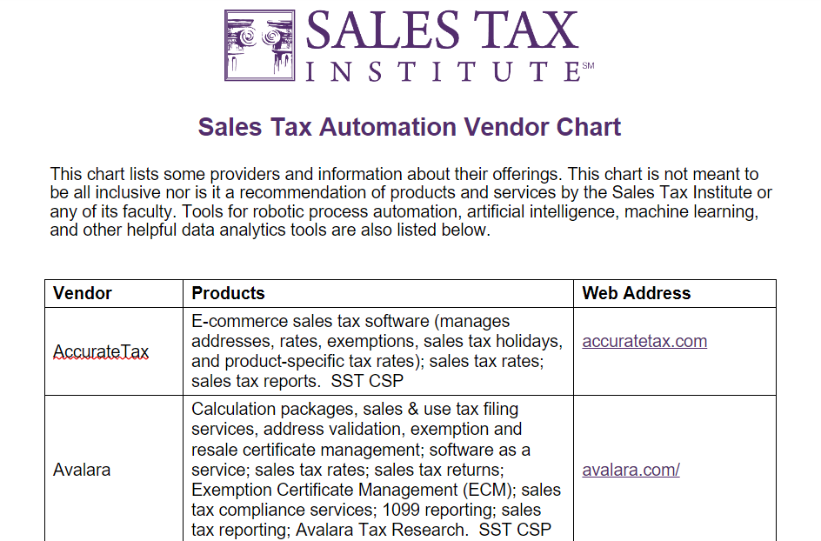
Sales Tax Automation Vendor Chart
Bonus Tool - Sales Tax Automation Vendor Chart

Slide 56
Certified Service Providers

Slide 57
What is a Certified Service Provider?
A Certified Service Provider (CSP) is an agent certified under the Streamlined Sales and Use Tax Agreement or other state provision to perform all the seller's sales and use tax functions, other than the seller's obligation to remit tax on its own purchases.
A CSP is designed to allow a business to outsource most of its sales tax administration responsibilities.
CSP services are provided free to sellers in the Streamlined Member states in which the seller is a "CSP-compensated seller."

Slide 58
CSP Compensated Seller Definition
CSP Compensated Seller in a Streamlined State means a Seller that has registered pursuant to Article IV of SSUTA through the Central Registration System and:
The Seller meets all of the following criteria during the 12-month period preceding the date of registration with the Streamlined State:
  no fixed place of business for more than 30 days in the state
  less than $50,000 of Property in the state (average over 12 month period)
  less than $50,000 of Payroll in the state
  less than 25% of its total Property or Payroll in the state
  was not required to be registered to be a supplier to the state
Starting 9/1/20 limitations for related parties but can include MLM and Marketplace facilitators
For the full definition, visit https://www.streamlinedsalestax.org/Shared-Pages/faqs/FAQs---about-certified-service-providers

Slide 59
Benefits of Using a CSP
CSP Services provided at no charge to CSP Compensated Sellers:
  Set-up and integrate the Contractor’s certified automated system (CAS) with the seller’s system, including a product mapping process
  Calculate the amount of tax due on a transaction at the time of the sale
  Generate and file the required sales and use tax returns
  Respond to notices
  Protect the privacy of tax information
  Maintain compliance with the provisions of the Minimum Standards for Certification contained in the SSTGB Rules and Procedures

Slide 60






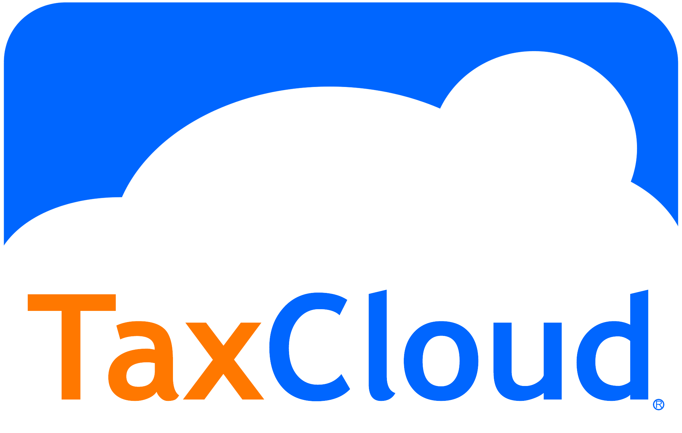
SST CSP Providers
Offering free services under CSP:
Not offering free services:
For Exactor product

Slide 61
Non SST CSP
A few states have adopted CSP provision as part of their economic nexus provisions
Pennsylvania
  Operational and is available for true remote sellers
  Avalara, Sovos and TaxCloud are authorized CSPs
  https://www.revenue.pa.gov/TaxTypes/SUT/OnlineRetailers/Pages/Certified-Service-Providers.aspx
Illinois and New Mexico not yet operational
  https://tax.illinois.gov/research/taxinformation/sales/certified-service-providers-certified-automated-systems-information.html

Slide 62
CSPs and Audit Liability
A seller’s audit liability changes depending on whether or not they use a CSP.
If a seller uses a CSP, under audit:
  The CSP is responsible for taxability, tax rates, tax calculation, and tax boundaries.
  The seller is responsible for the correct mapping of their products to the tax categories and anything related to exemption certificates.

Slide 63

Should I Use a CSP?
Pros:
If you are a CSP Compensated seller, the state pays for your fees if you use a CSP
Simplified registration and account maintenance
If your ERP/Webstore has a connection to a CSP
Considerations:
To get TN amnesty need to register in all states where make sales
If don’t register as a volunteer, state could ask for more information
Most benefits if use a CSP

Slide 64
Robotic Process Automation (RPA) and Artificial Intelligence (AI)

Slide 65

Robotic Process Automation (RPA) and Artificial Intelligence (AI)
RPA and AI will have a significant impact on indirect tax automation.
There are different technologies available that can be utilized to assist with different tax functions.

Slide 66
How Can These Technologies Be Used?
RPA
  Utilizes bots to perform repetitive tasks that would otherwise be done by a human.
  Possible Uses:
    Data/GL Reconciliation
    Filling out forms
    Reviewing data to identify discrepancies

Slide 67

How Can These Technologies Be Used?
Machine Learning (ML)/AI
  Software designed to make intelligent decisions. Learns and adapts on its own.
  Possible Uses:
    Tax code mapping
    Extracting rates and rules from DOR websites
Data Analytics
  Possible Uses:
    Tax trends and anomalies
    Nexus dashboards

Slide 68
How Can These Technologies Be Used?
Exemption Certificate Management
  Leverage multiple technology solutions to streamline certificate requests
  New customer orders: Automatically request certificates where none exist.
  Renewals: Automatic evaluation of expiring certificates and re-request.
  Receipt of certificates: AI/ML - Review flagging for human review based on ML-assigned confidence interval

Slide 69
How Can These Technologies Be Used?
Automated Product Mapping
  Workflow trigger when new product created
  ML for natural language processing to interpret product names and descriptions
  Apply exception-based human intervention when the confidence interval for product mapping doesn’t meet minimum threshold
  Feedback loop to machine learning to improve understanding based on human decision making
  Based on determined product mapping, apply necessary data configuration in ERP or tax engine to ensure appropriate taxability occurs
  Periodic human review of mappings to improve ML

Slide 70
How To Integrate These Technologies
Examine your existing process/workflow
Do a Cost/Benefit analysis
Determine which technology is best suited for the task
Steps associated with each
  RPA – Document the steps of the process and identify which steps can be implemented through an RPA platform.
  ML/AI – Ensure that there are large amounts of training data and evaluate algorithms best suited based on the use case.
  Analytics – Plug data into the analytics platform to generate reports, insights, etc.

Slide 71




Sales Tax Specific AI Tools
Recent acquisition from Ryan

Slide 72


Sales Tax Specific AI Tools
CORDIANCE MODIOS
Modios is a next generation intelligence platform designed to manage your business data and tax engine implementations for Vertex, ONESOURCE, and Avalara.
Rapid verify
Rapid insight
Rapid testing
Product mapping accelerator

Slide 73
Questions & Comments
Diane Yetter
Sales Tax Institute
diane@salestaxinstitute.com
312.701.1800, ext. 2

Slide 74
On-Demand Webinars
New courses now available! – Including 2 new Bundles!
Sales Tax 101
Sales Tax Registration Deep Dive
Sales Tax Compliance Deep Dive
Administering the Sales Tax Function
Drop Shipments Post-Wayfair
Starting a New Business or Initiative
The Great Exemption Adventure
Audit Defense Best Practices
Challenges with Services
Effective Tax Research
Software, Digital Goods, NFTs, and Digital Currency
Use Tax Accrual for Automated and Manual Processes
Taxation of Rentals and Leases: Puzzle Solved!
Blueprint for Success: Sales Tax Essentials for Construction & Real Property
Navigating Sales Tax in M&A Deals
Sales Tax Resources: Your Essential Toolkit
Gross Receipts Tax: What Makes Them Special
NEW- European Value Added Tax

Slide 75
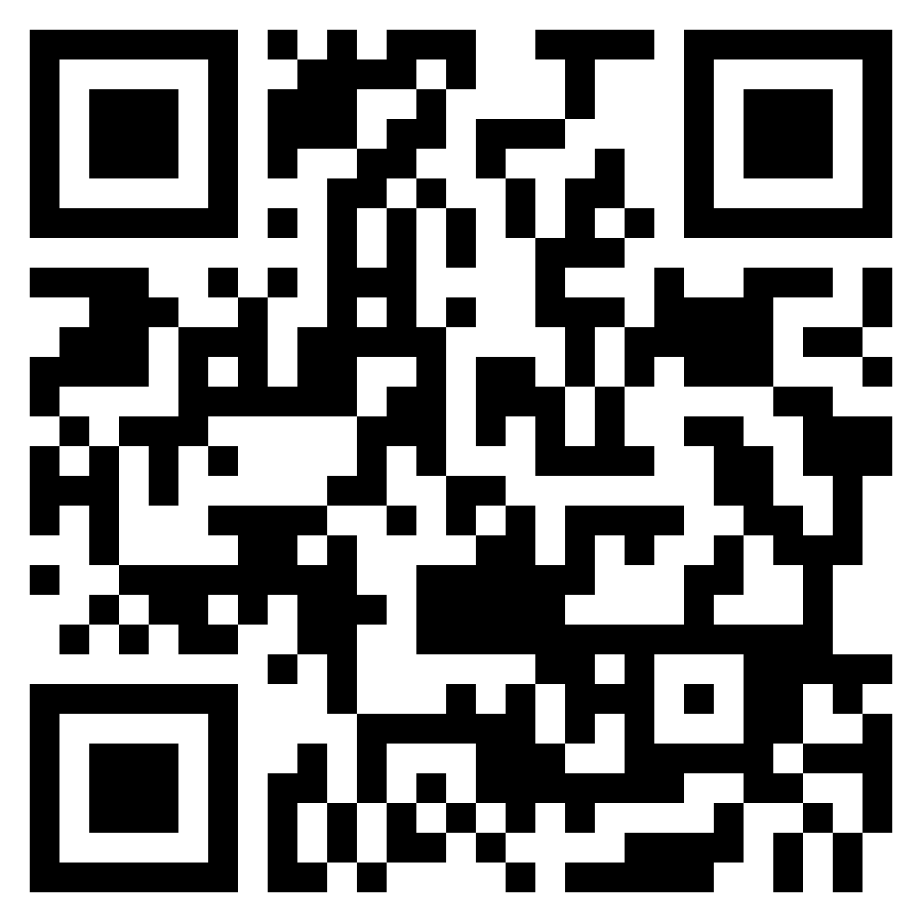
Sales Tax Institute Linked In Group
Join the Sales Tax Institute’s LinkedIn group, exclusively for Sales Tax Institute course attendees!
Post questions, ideas, practical suggestions and news updates that you think will be relevant to other Sales Tax Institute alumni.
We will be moderating the group, and we will remove inappropriate content posts so that this stays as a resource for our students to help them develop their sales tax expertise and ask questions.

Slide 76
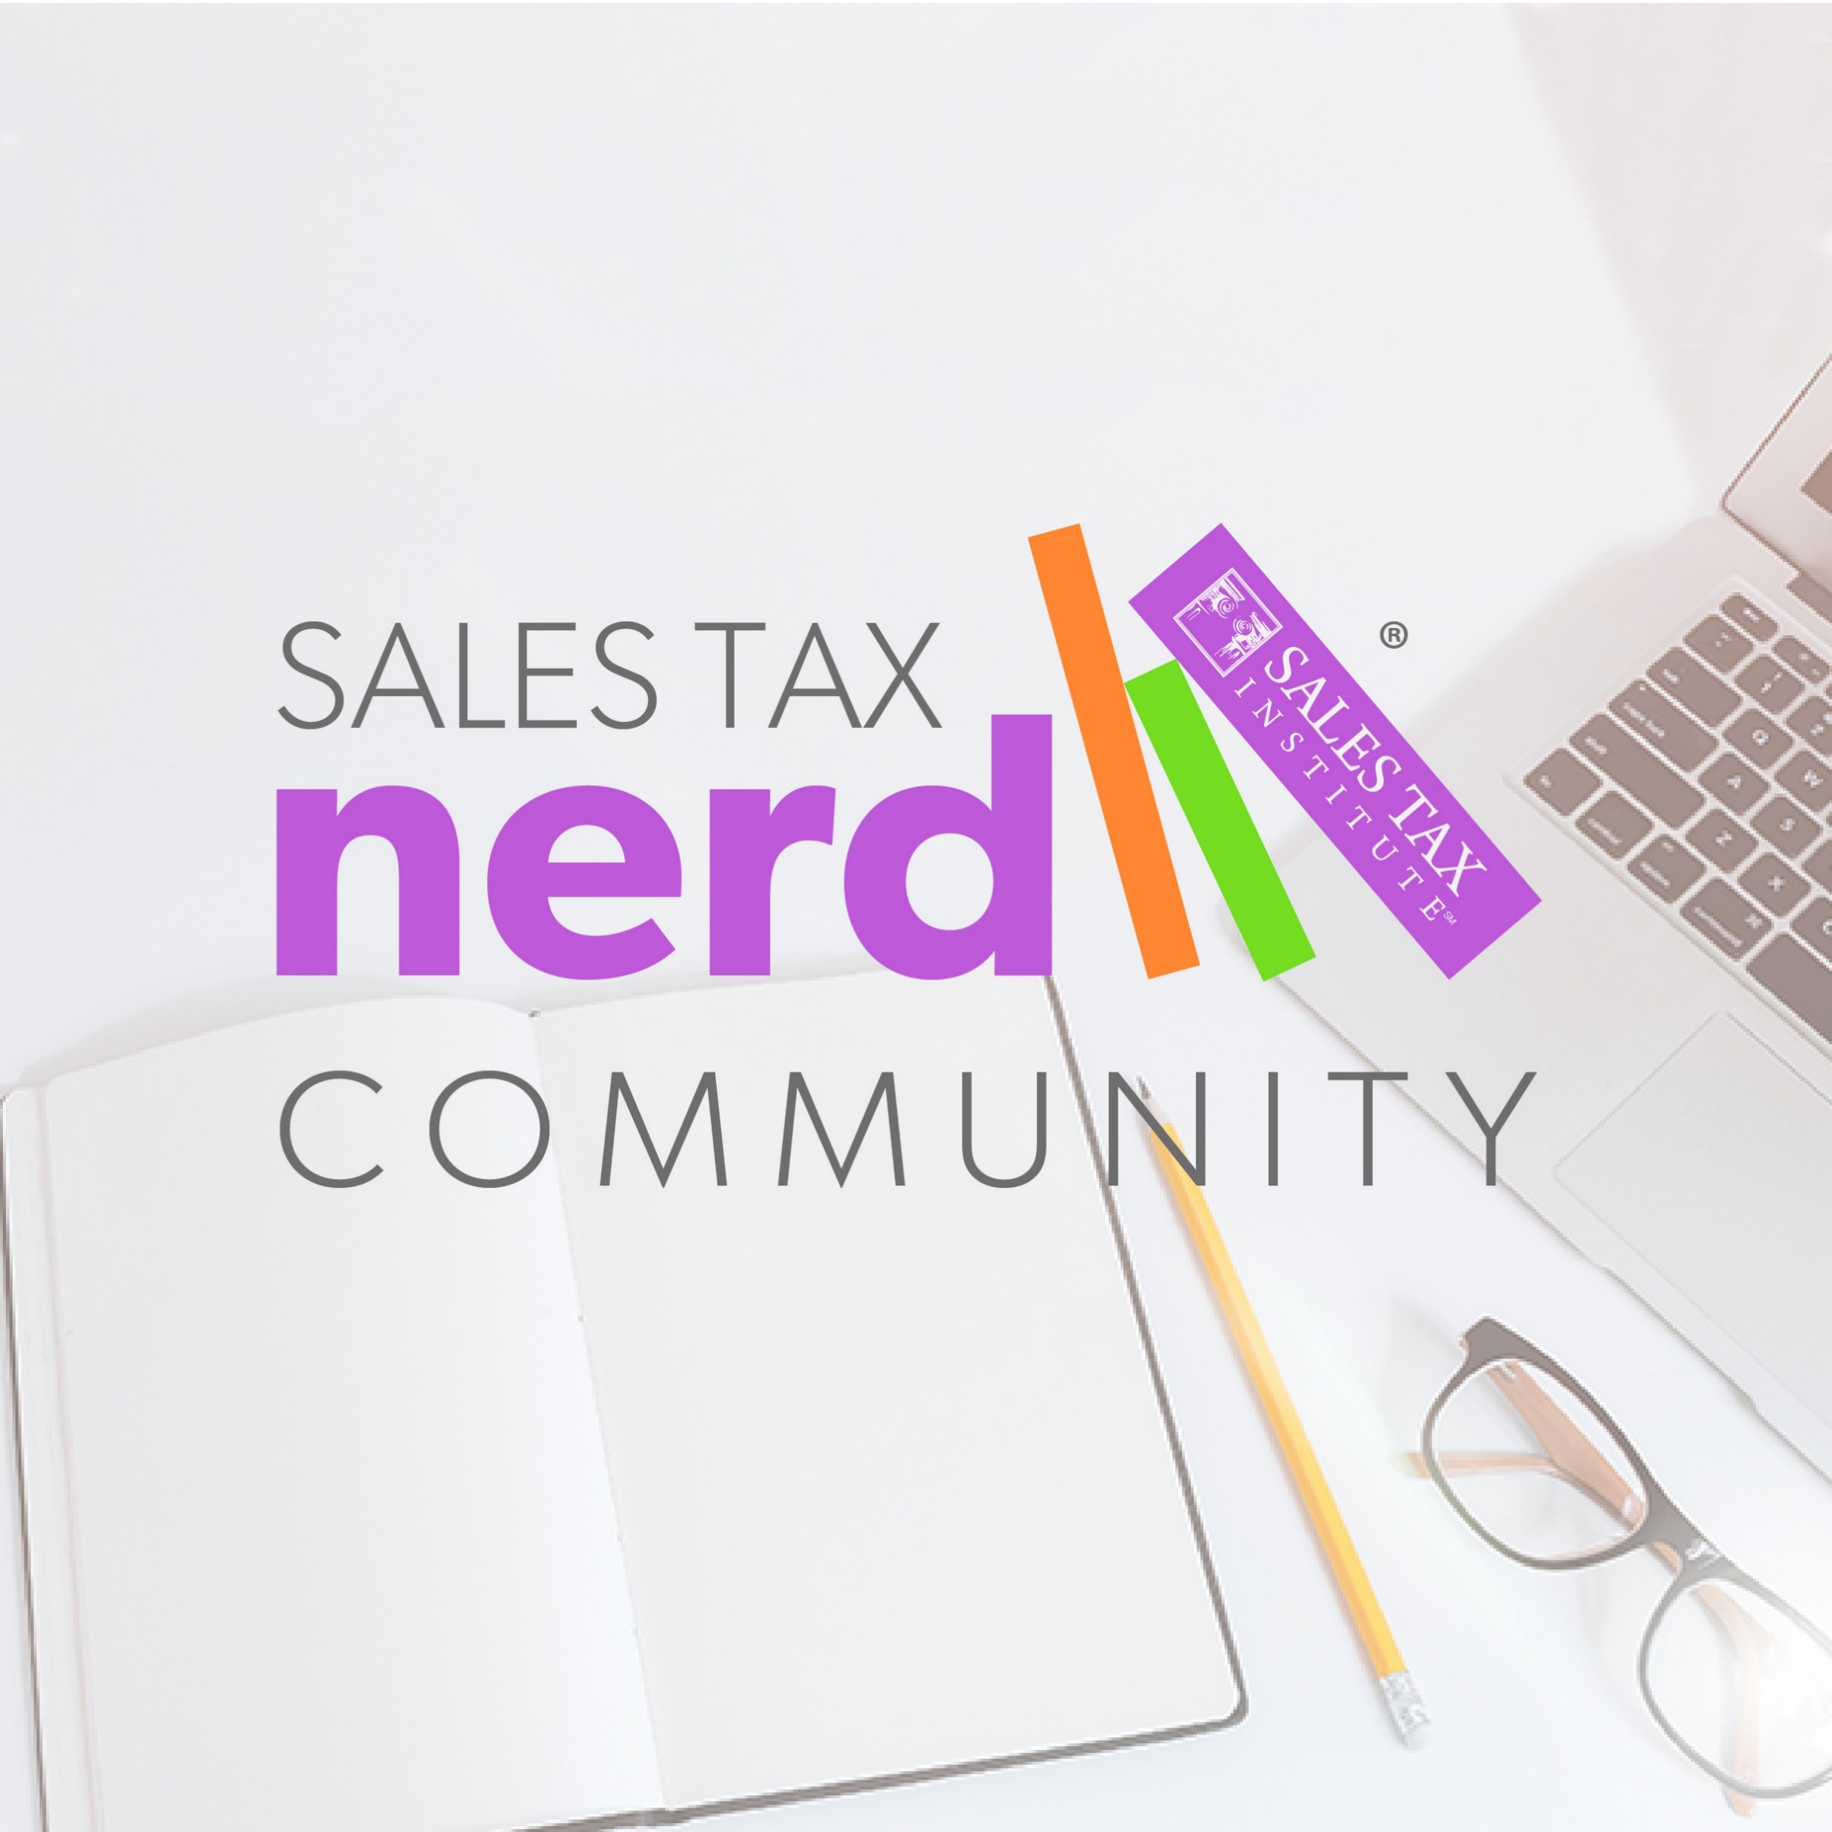






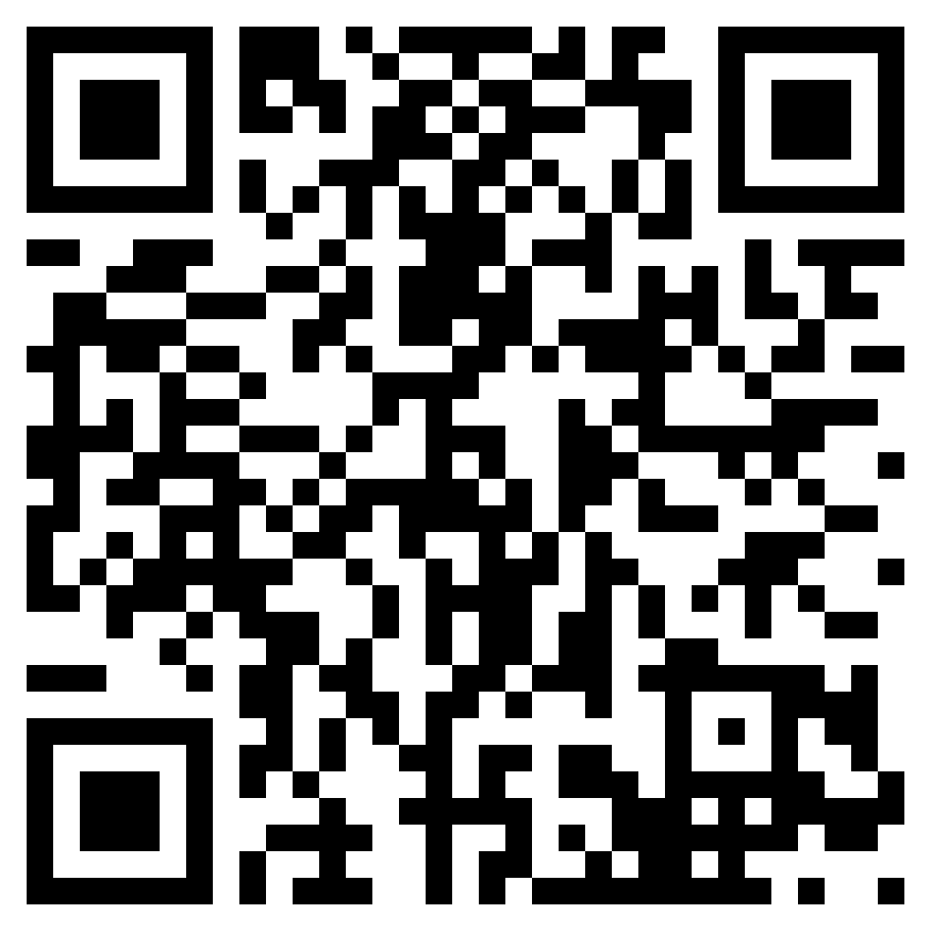
Sales Tax Nerd Community Membership
https://www.salestaxinstitute.com/sales-tax-nerd-community-membership
Save 10% with code WEBINAR10
Exclusive Online Platform to connect with Peers and STI
A year of live webinars and unlimited
on-demand webinars
Quarterly Office Hours with Diane
Sales Tax Tools Library
Course Discounts
Mentoring Program
….And much more!

Slide 77



Thanks to our Sponsors!

Slide 78




Thank you for watching!
/salestaxinstitute
Sales Tax Institute
910 W. Van Buren, Suite 100-321
Chicago, IL 60607
(312) 701-1800
/company/sales-tax-institute
/user/salestaxinstitute
webinars@salestaxinstitute.com
/salestaxinstitute/

